Slide 1
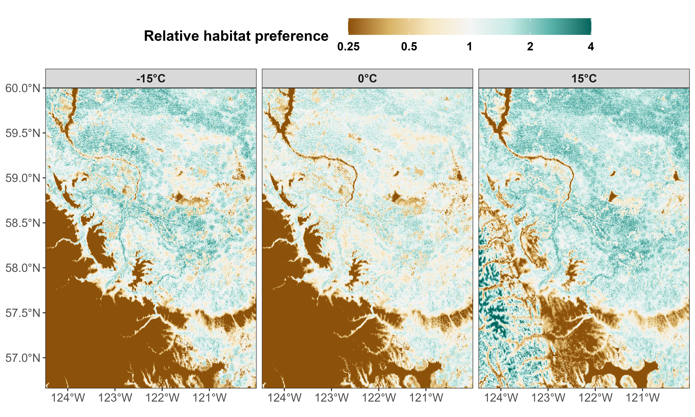
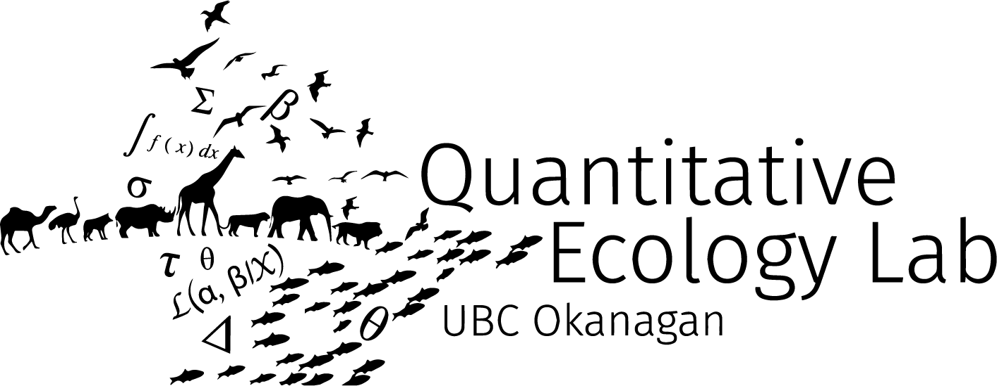

Effects of temperature on mammals’ movement and habitat selection in British Columbia, Canada
Stefano Mezzini
Ph.D. Biology candidate

Slide 2
Placing things on a map

Slide 3
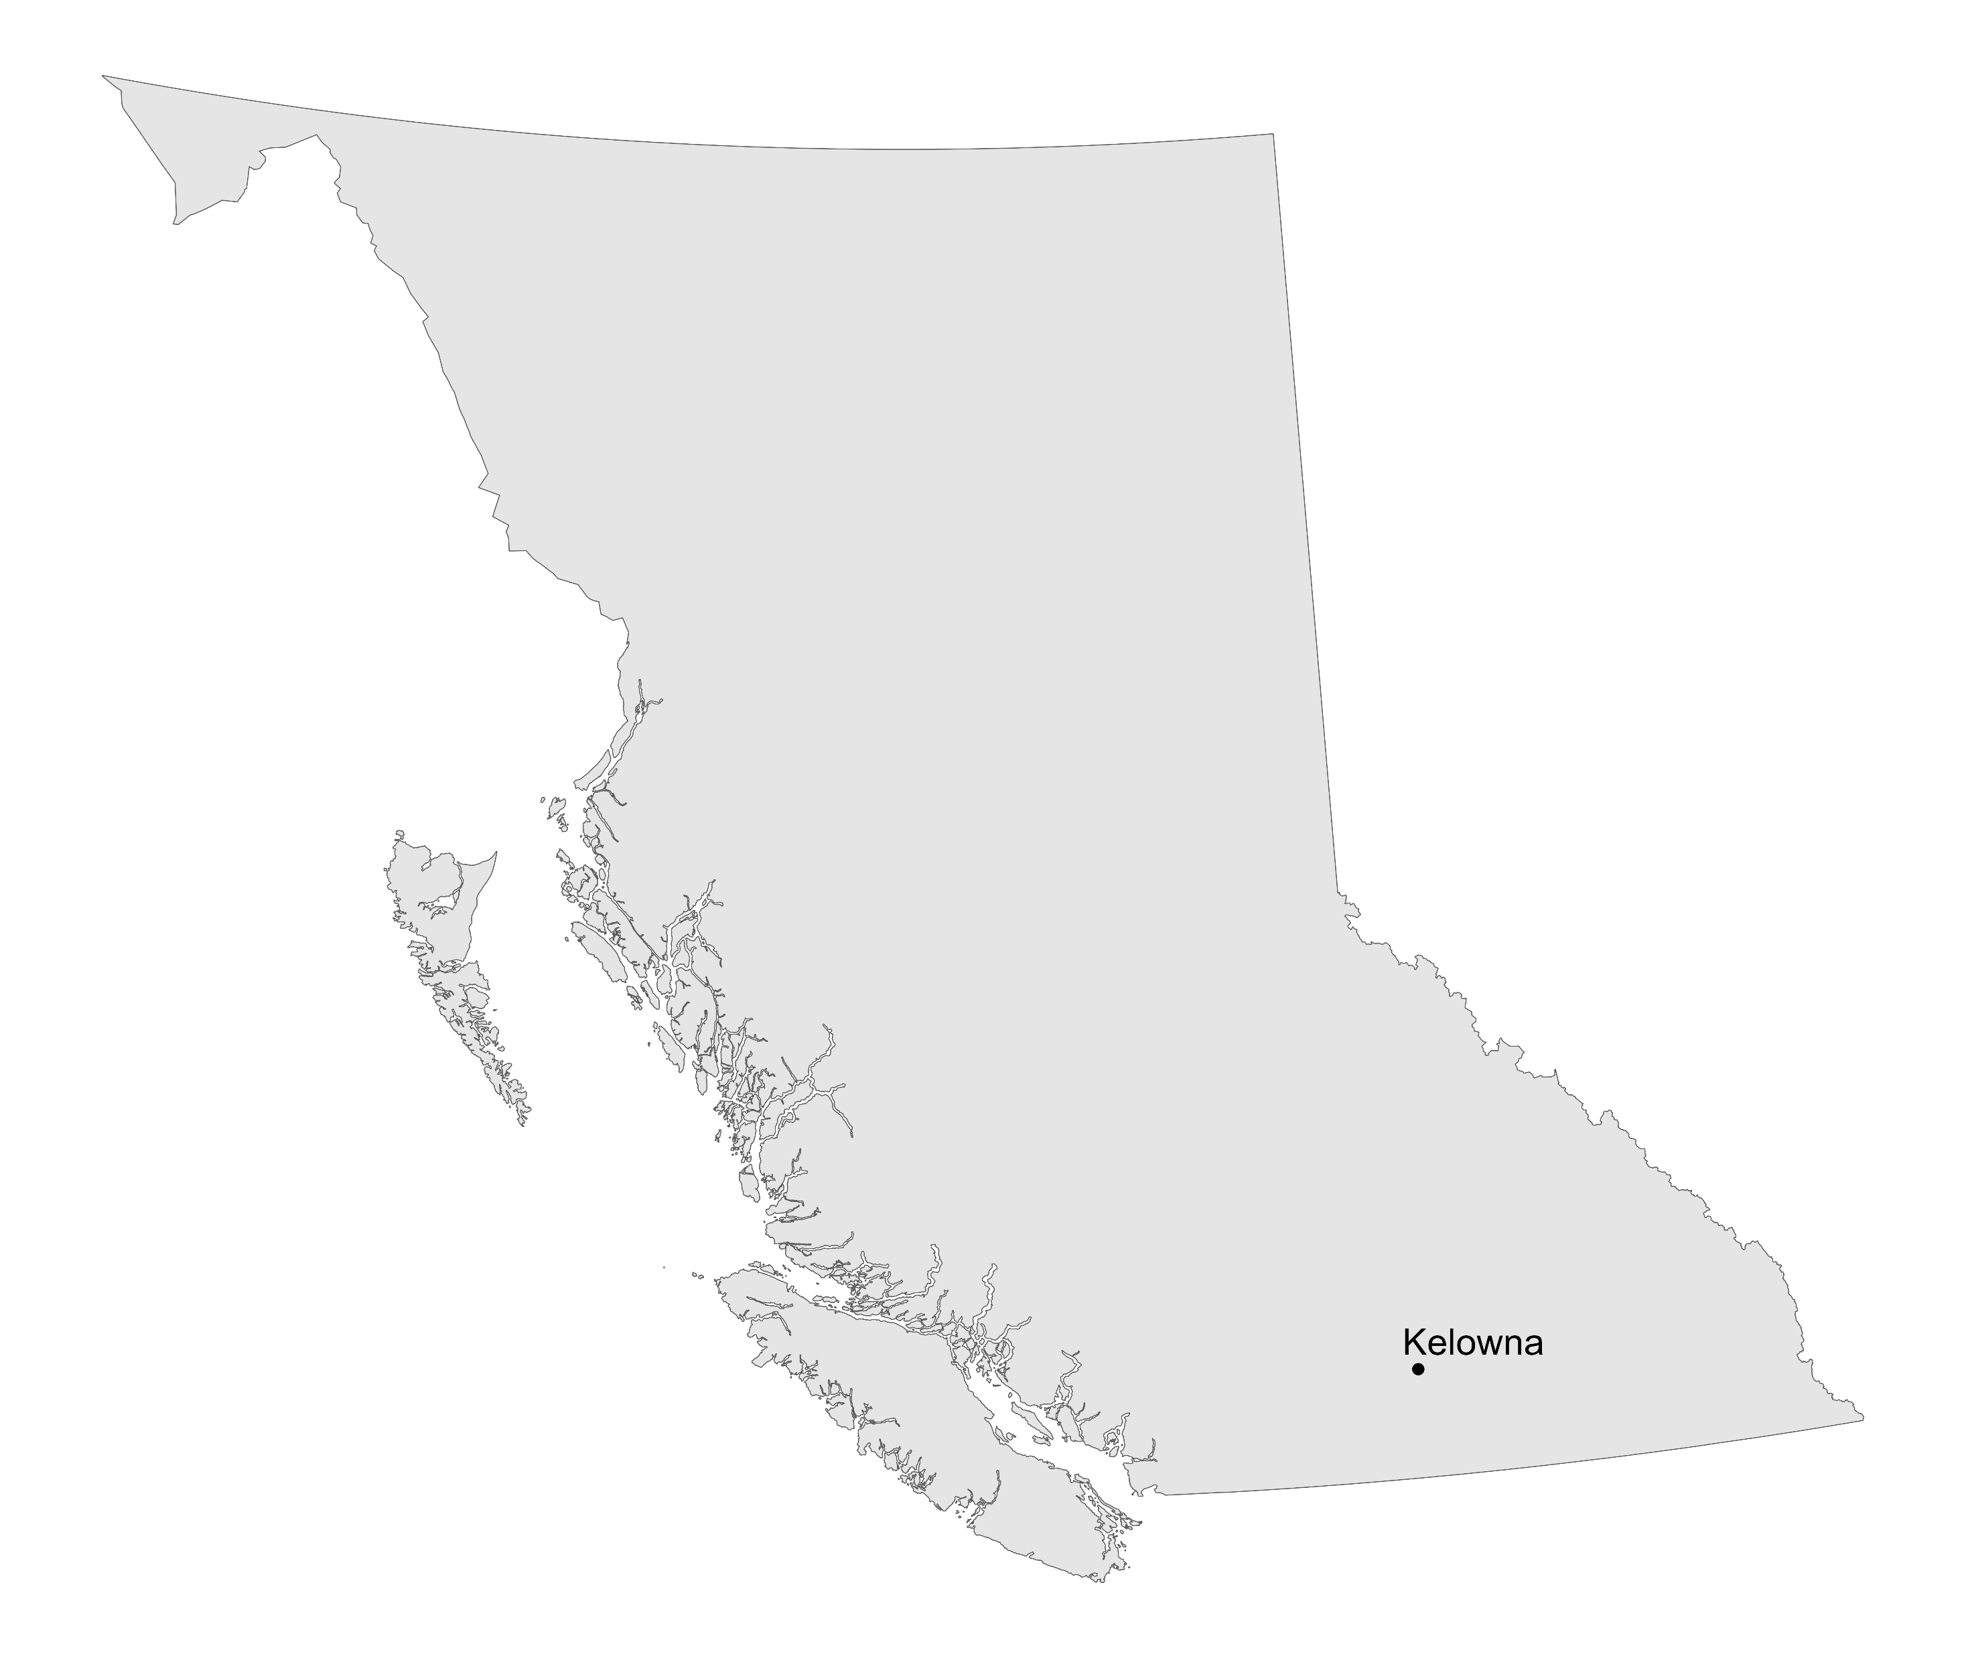

Slide 4
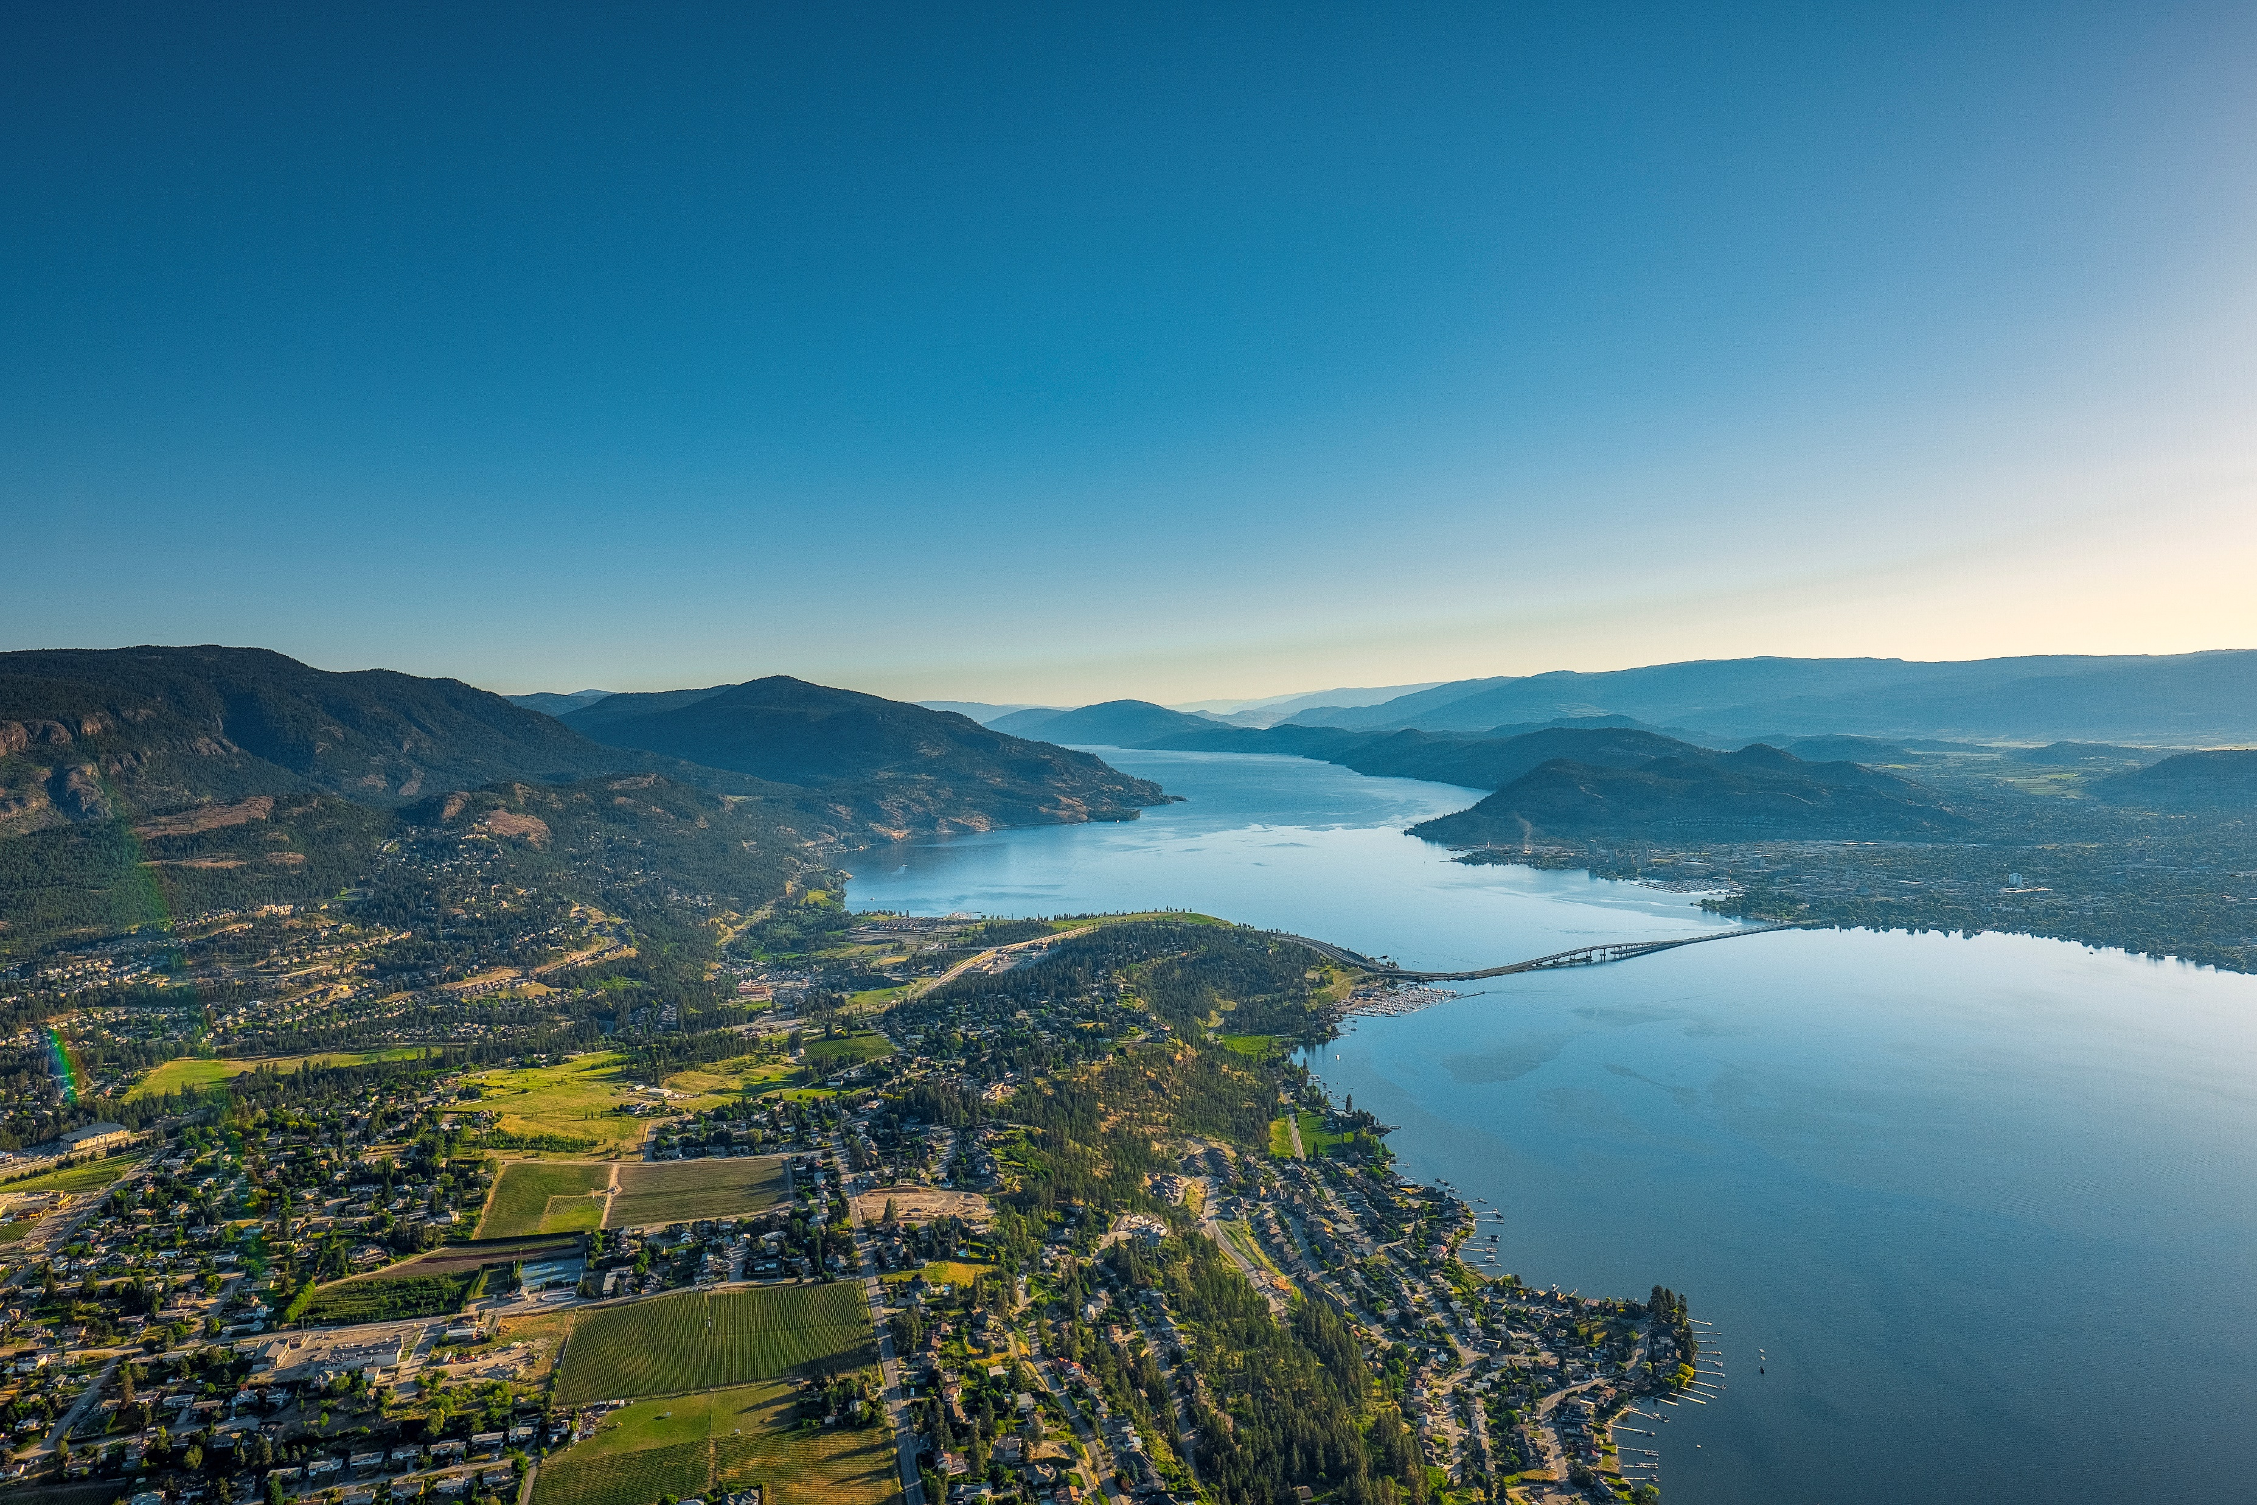
© University of British Columbia Okanagan

Slide 5
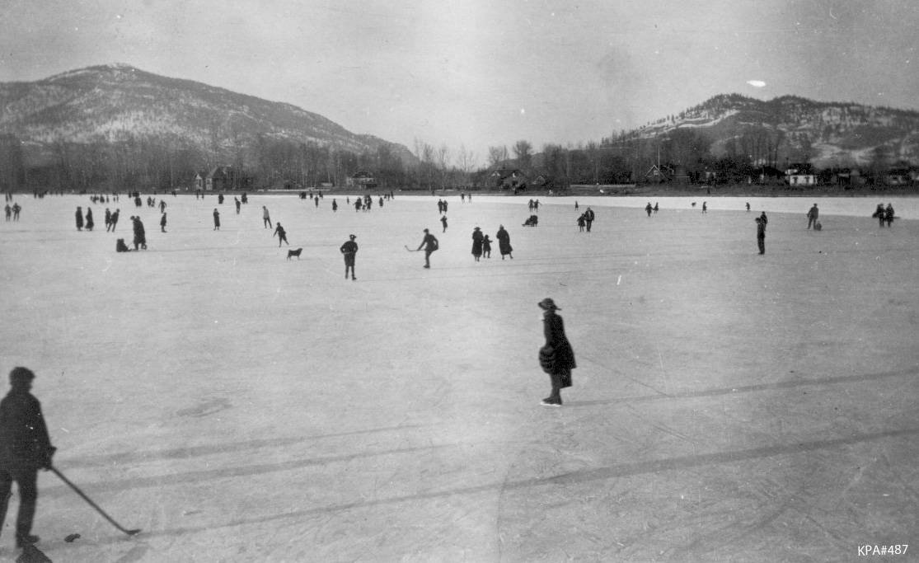
Things are not what they used to be 100 years ago
Kelowna Public Archives: KPA #487

Slide 6
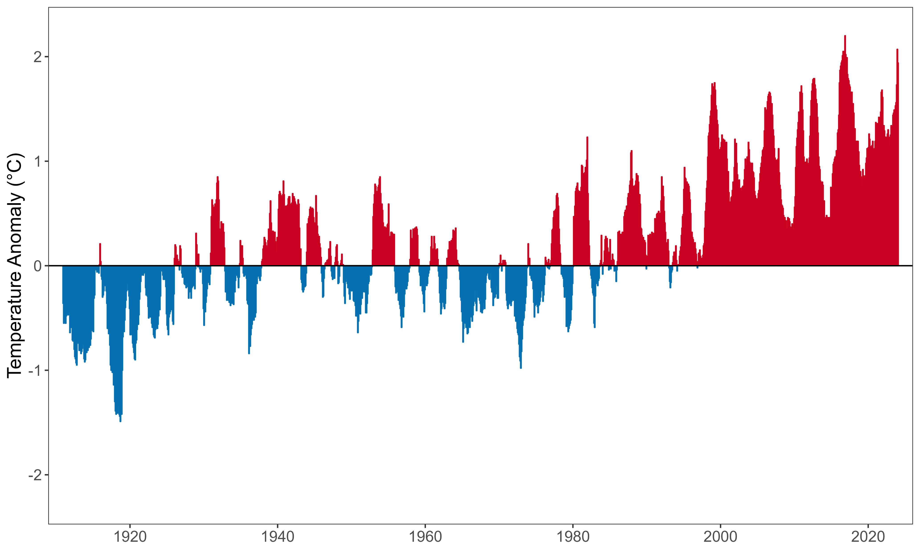
The climate is warming rapidly
(Relative to the 1910-2000 average)

Slide 7
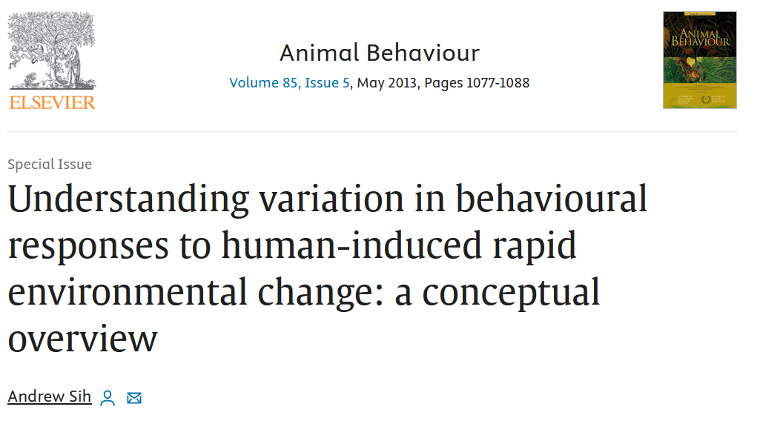
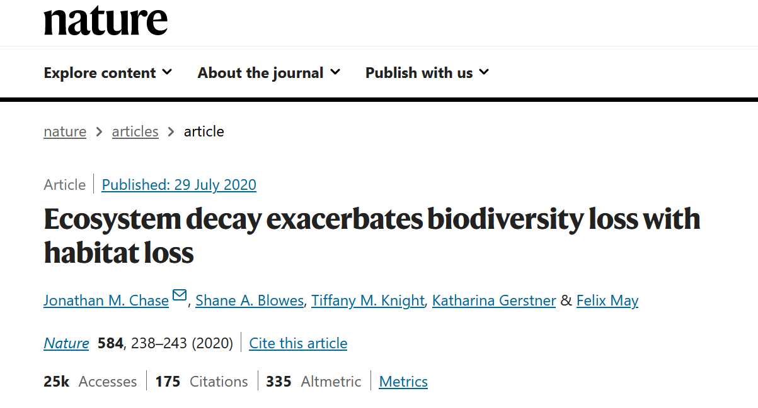
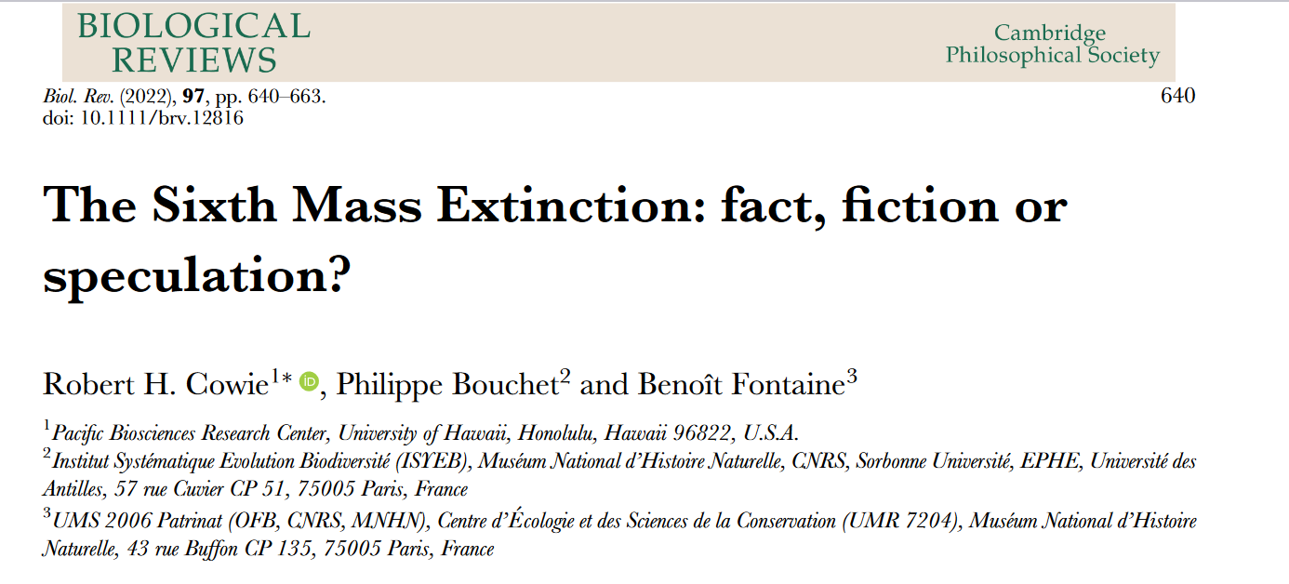
Habitats are not what they used to be 100 years ago
https://doi.org/10.1038/s41586-020-2531-2
https://doi.org/10.1016/j.anbehav.2013.02.017
https://doi.org/10.1111/brv.12816

Slide 8
What will BC look like in 100 years?

Slide 9





There are many things that affect mammal behavior

Slide 10
Temperature and movement

Slide 11
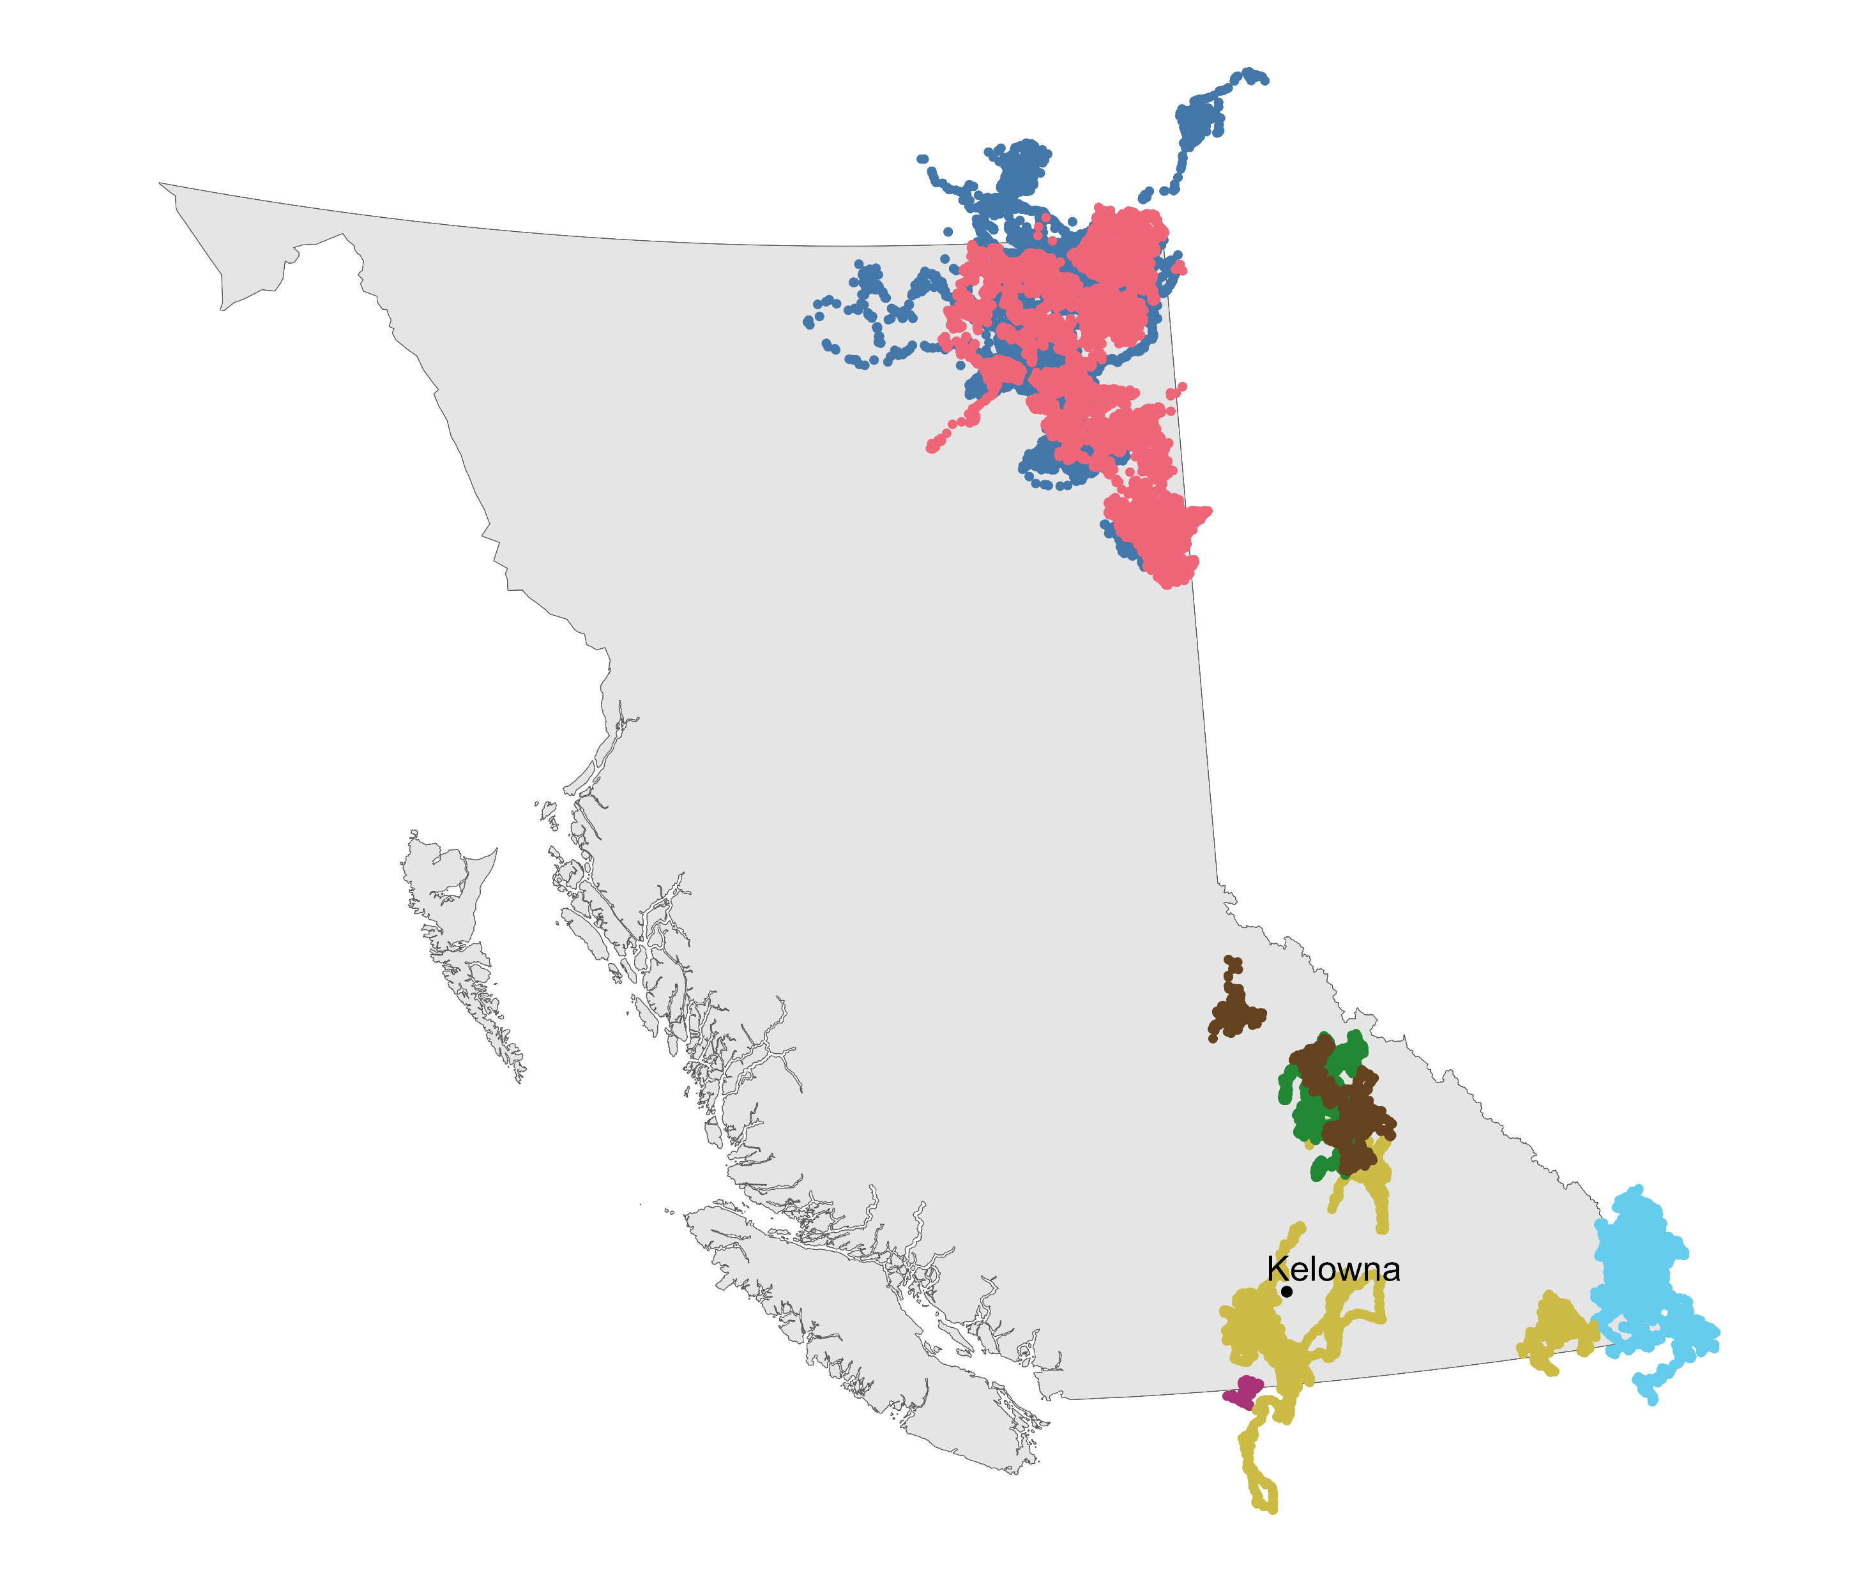
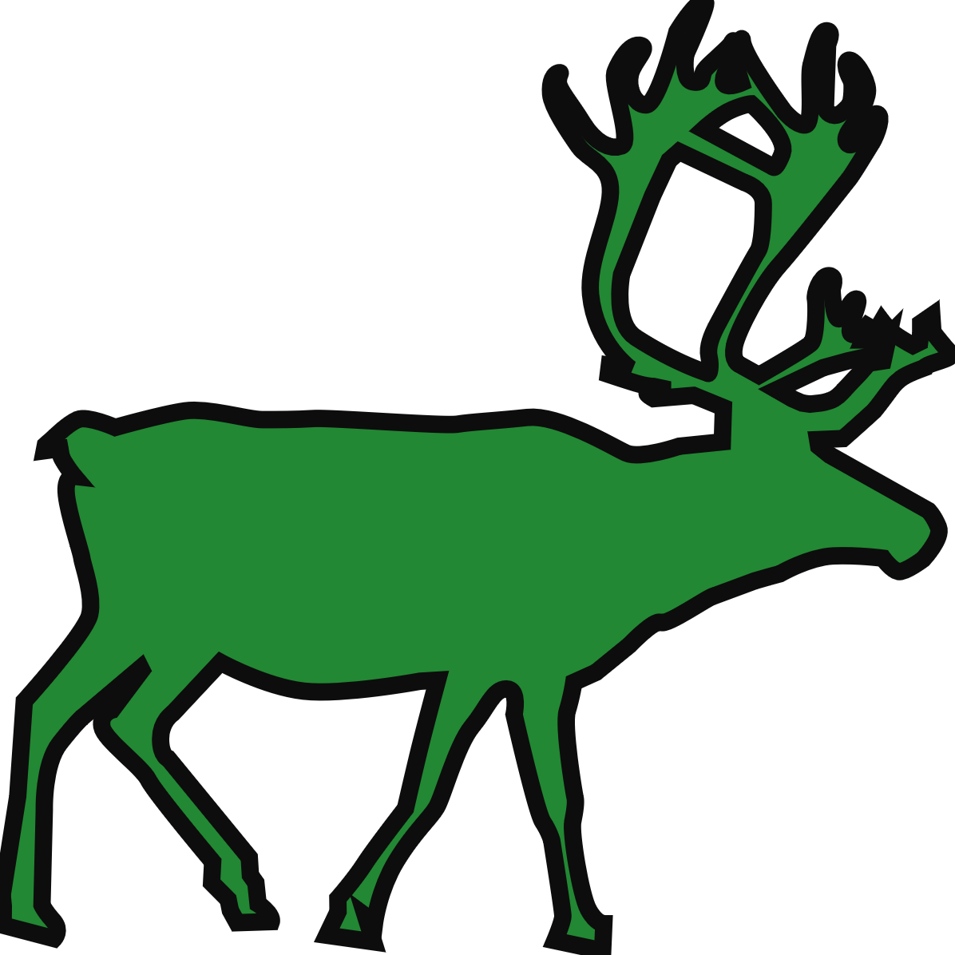


Slide 12
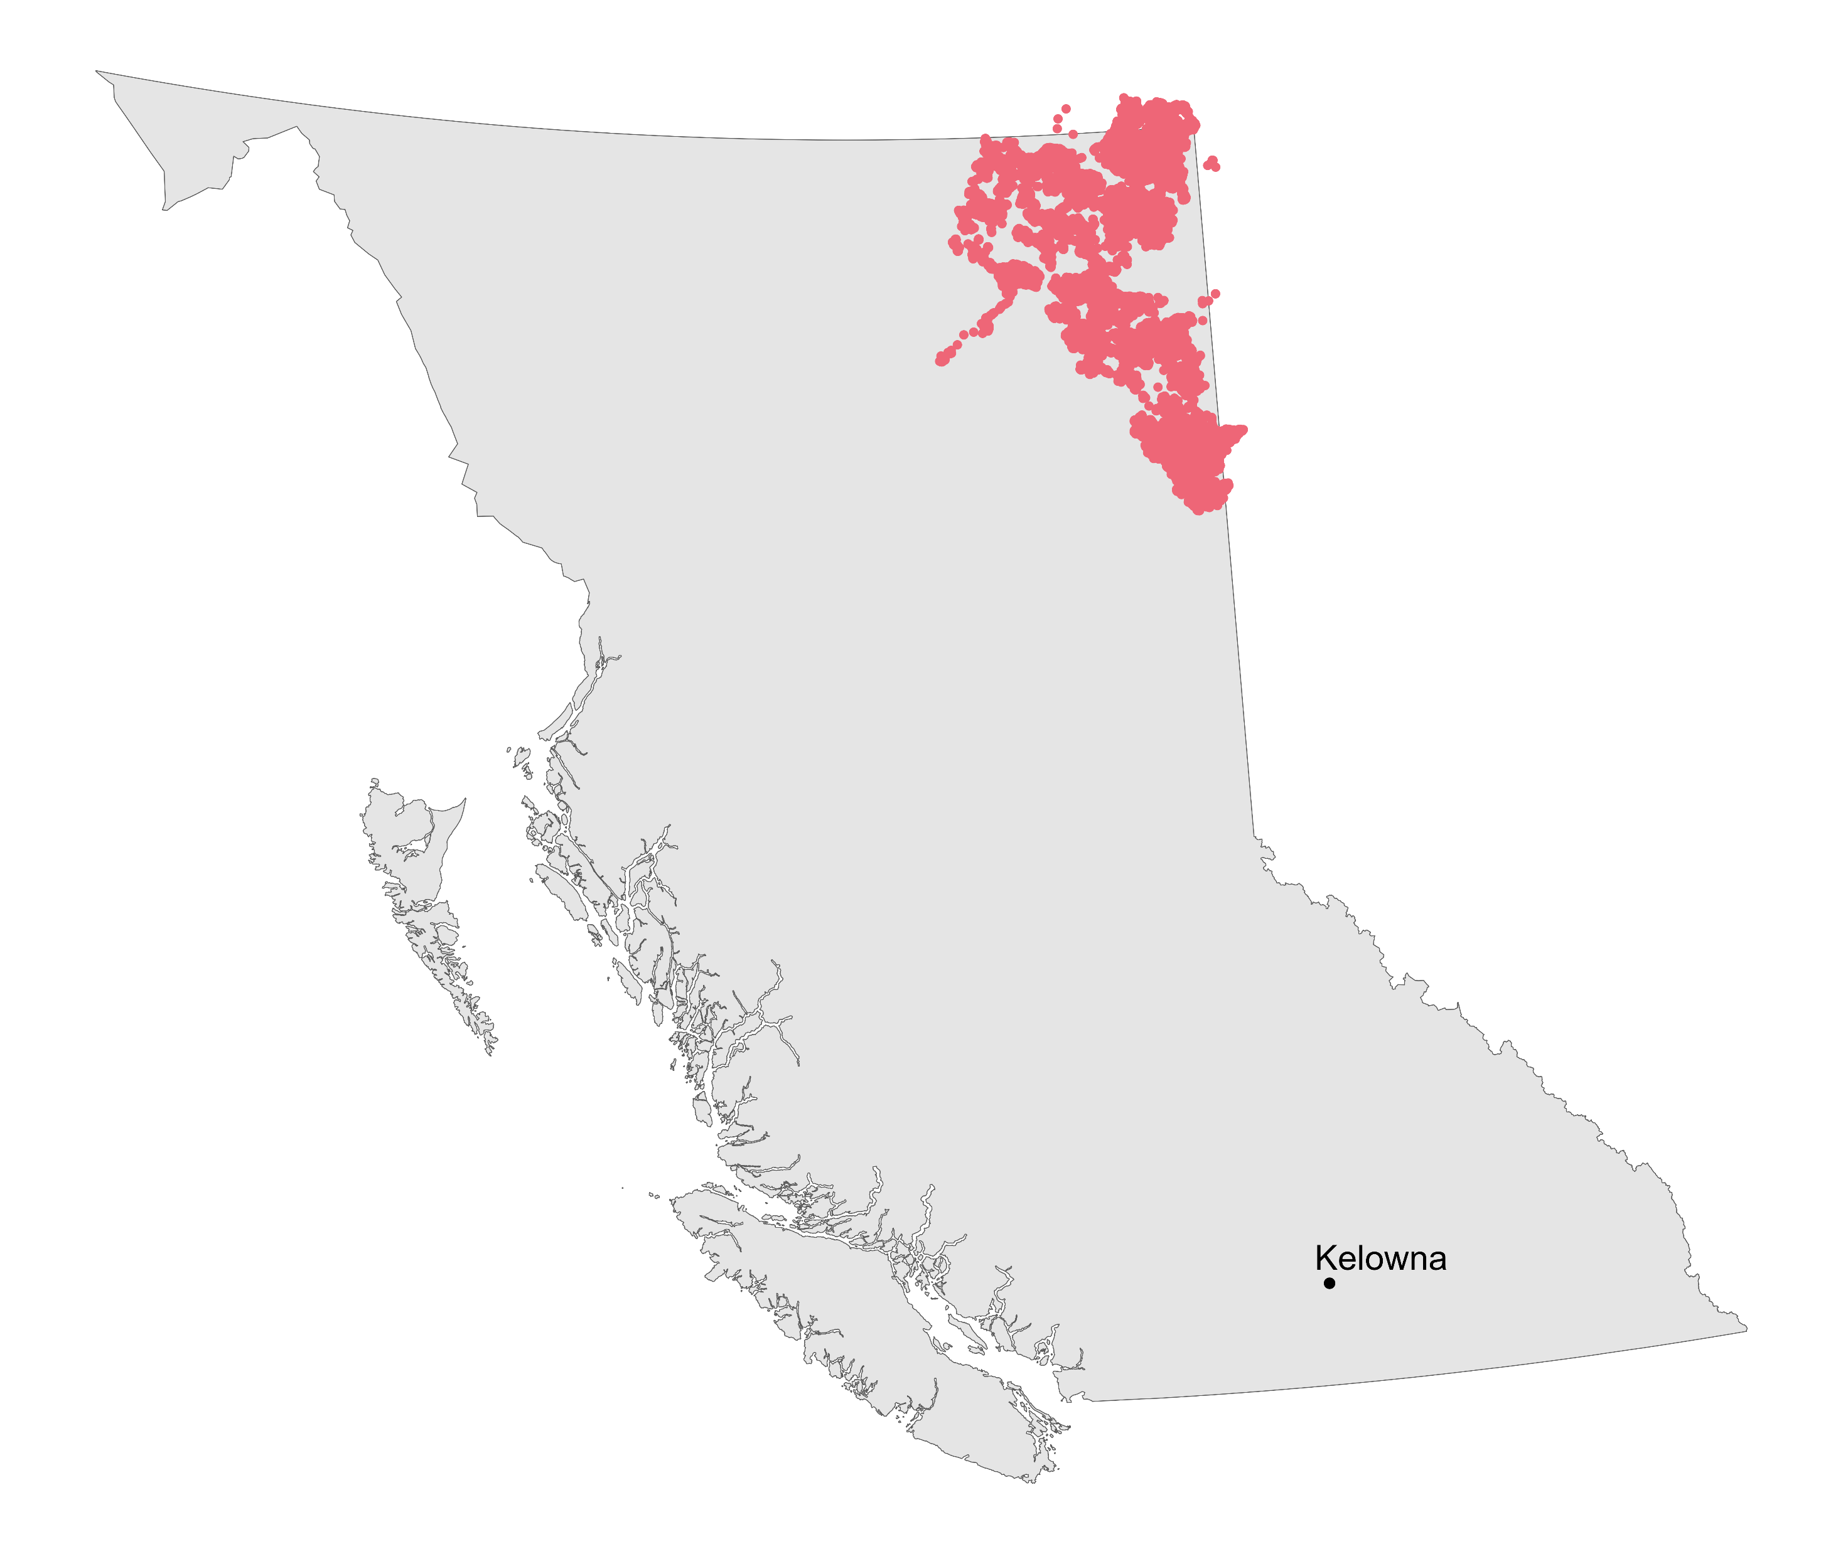

Slide 13
How does temperature affect how often boreal caribou move?

Slide 14
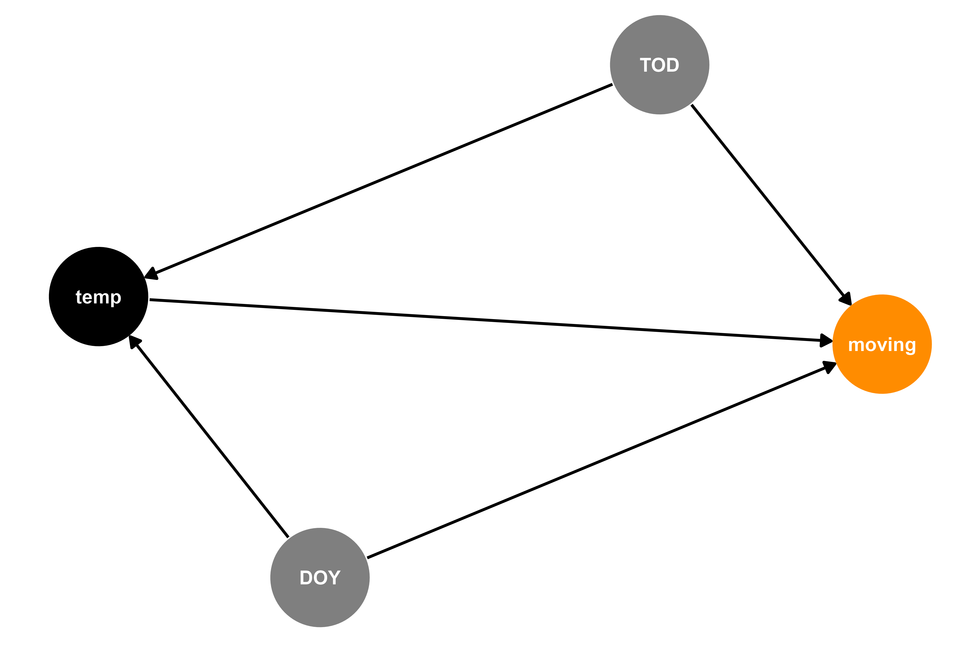


Modeling how often boreal caribou move

Slide 15
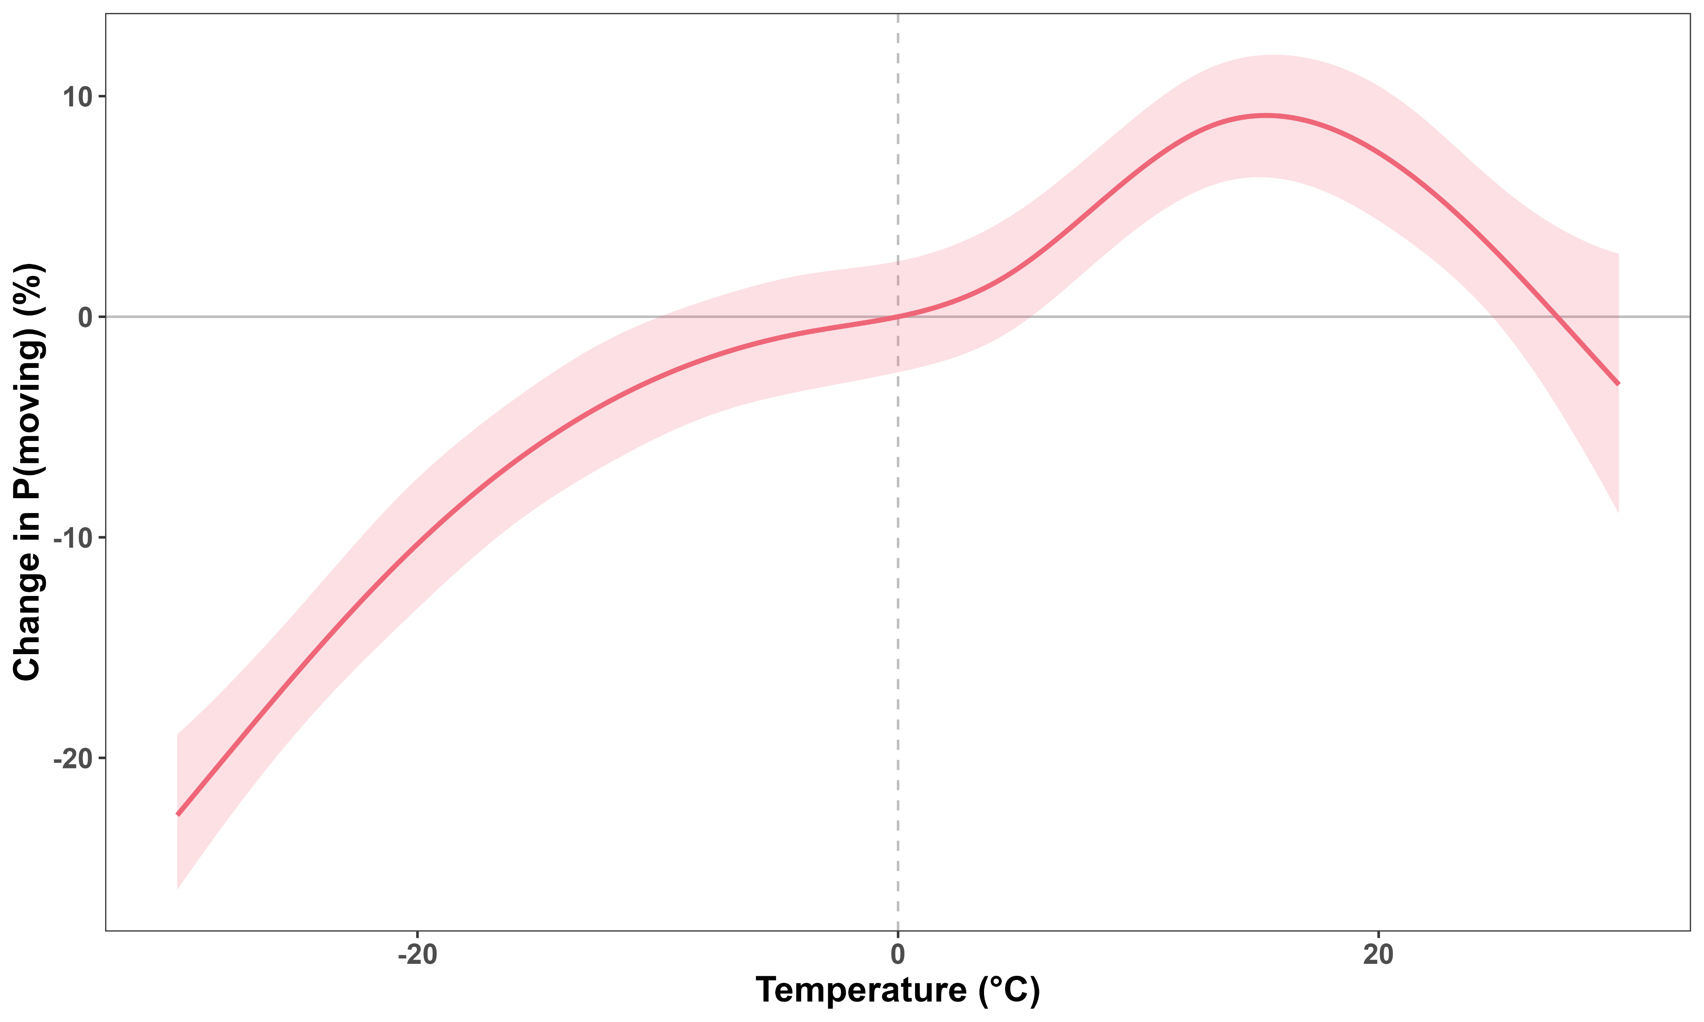
Caribou move more often at warmer temperatures

Slide 16
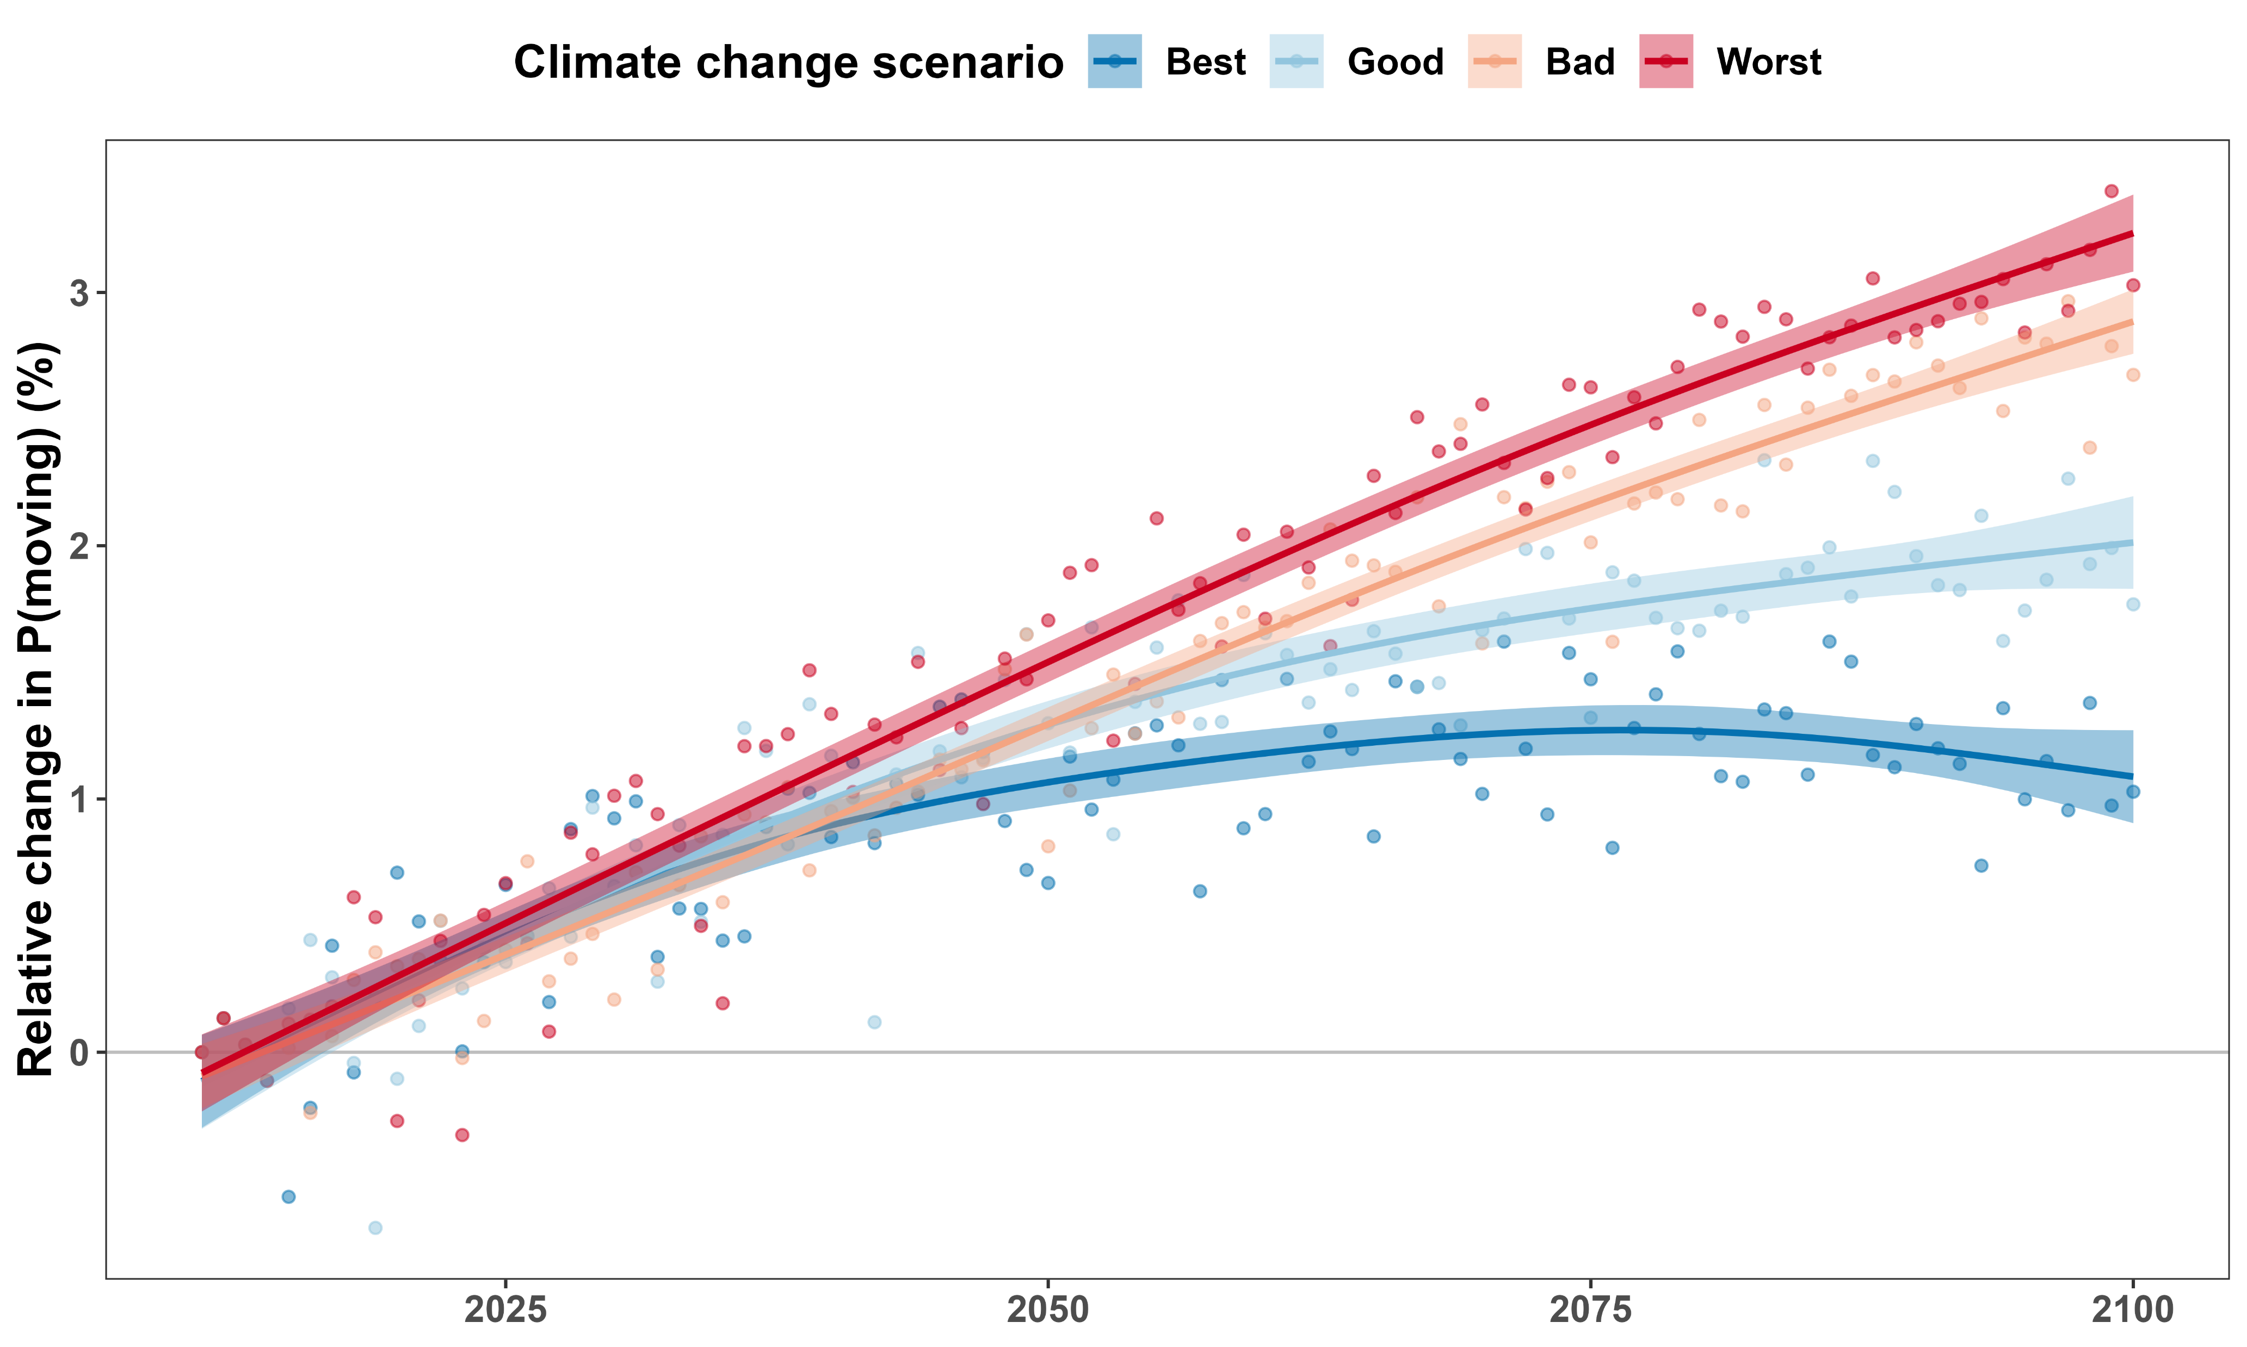
Boreal caribou will be moving a more often

Slide 17
How does temperature affect how fast boreal caribou move?

Slide 18

Modeling how fast boreal caribou move

Slide 19
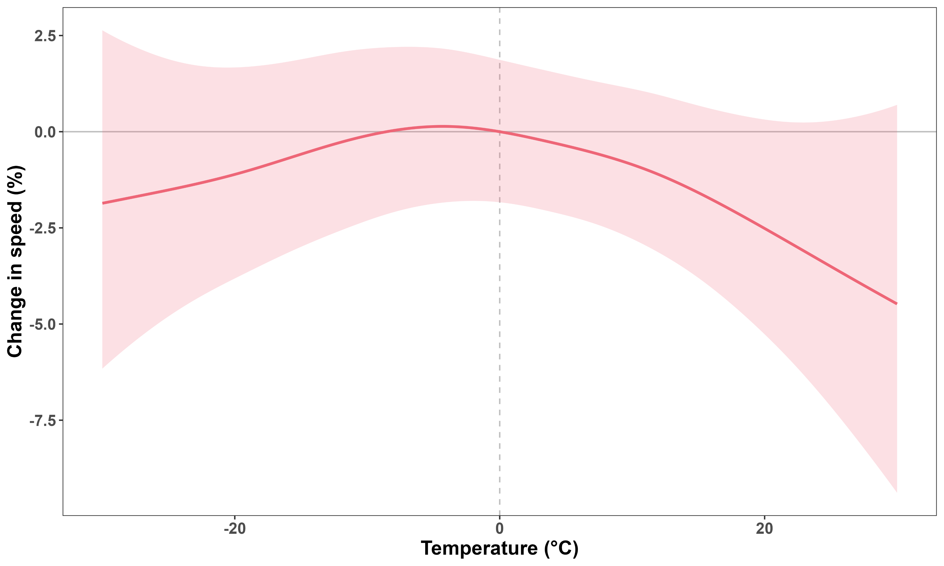
Temperature does not affect speed much

Slide 20
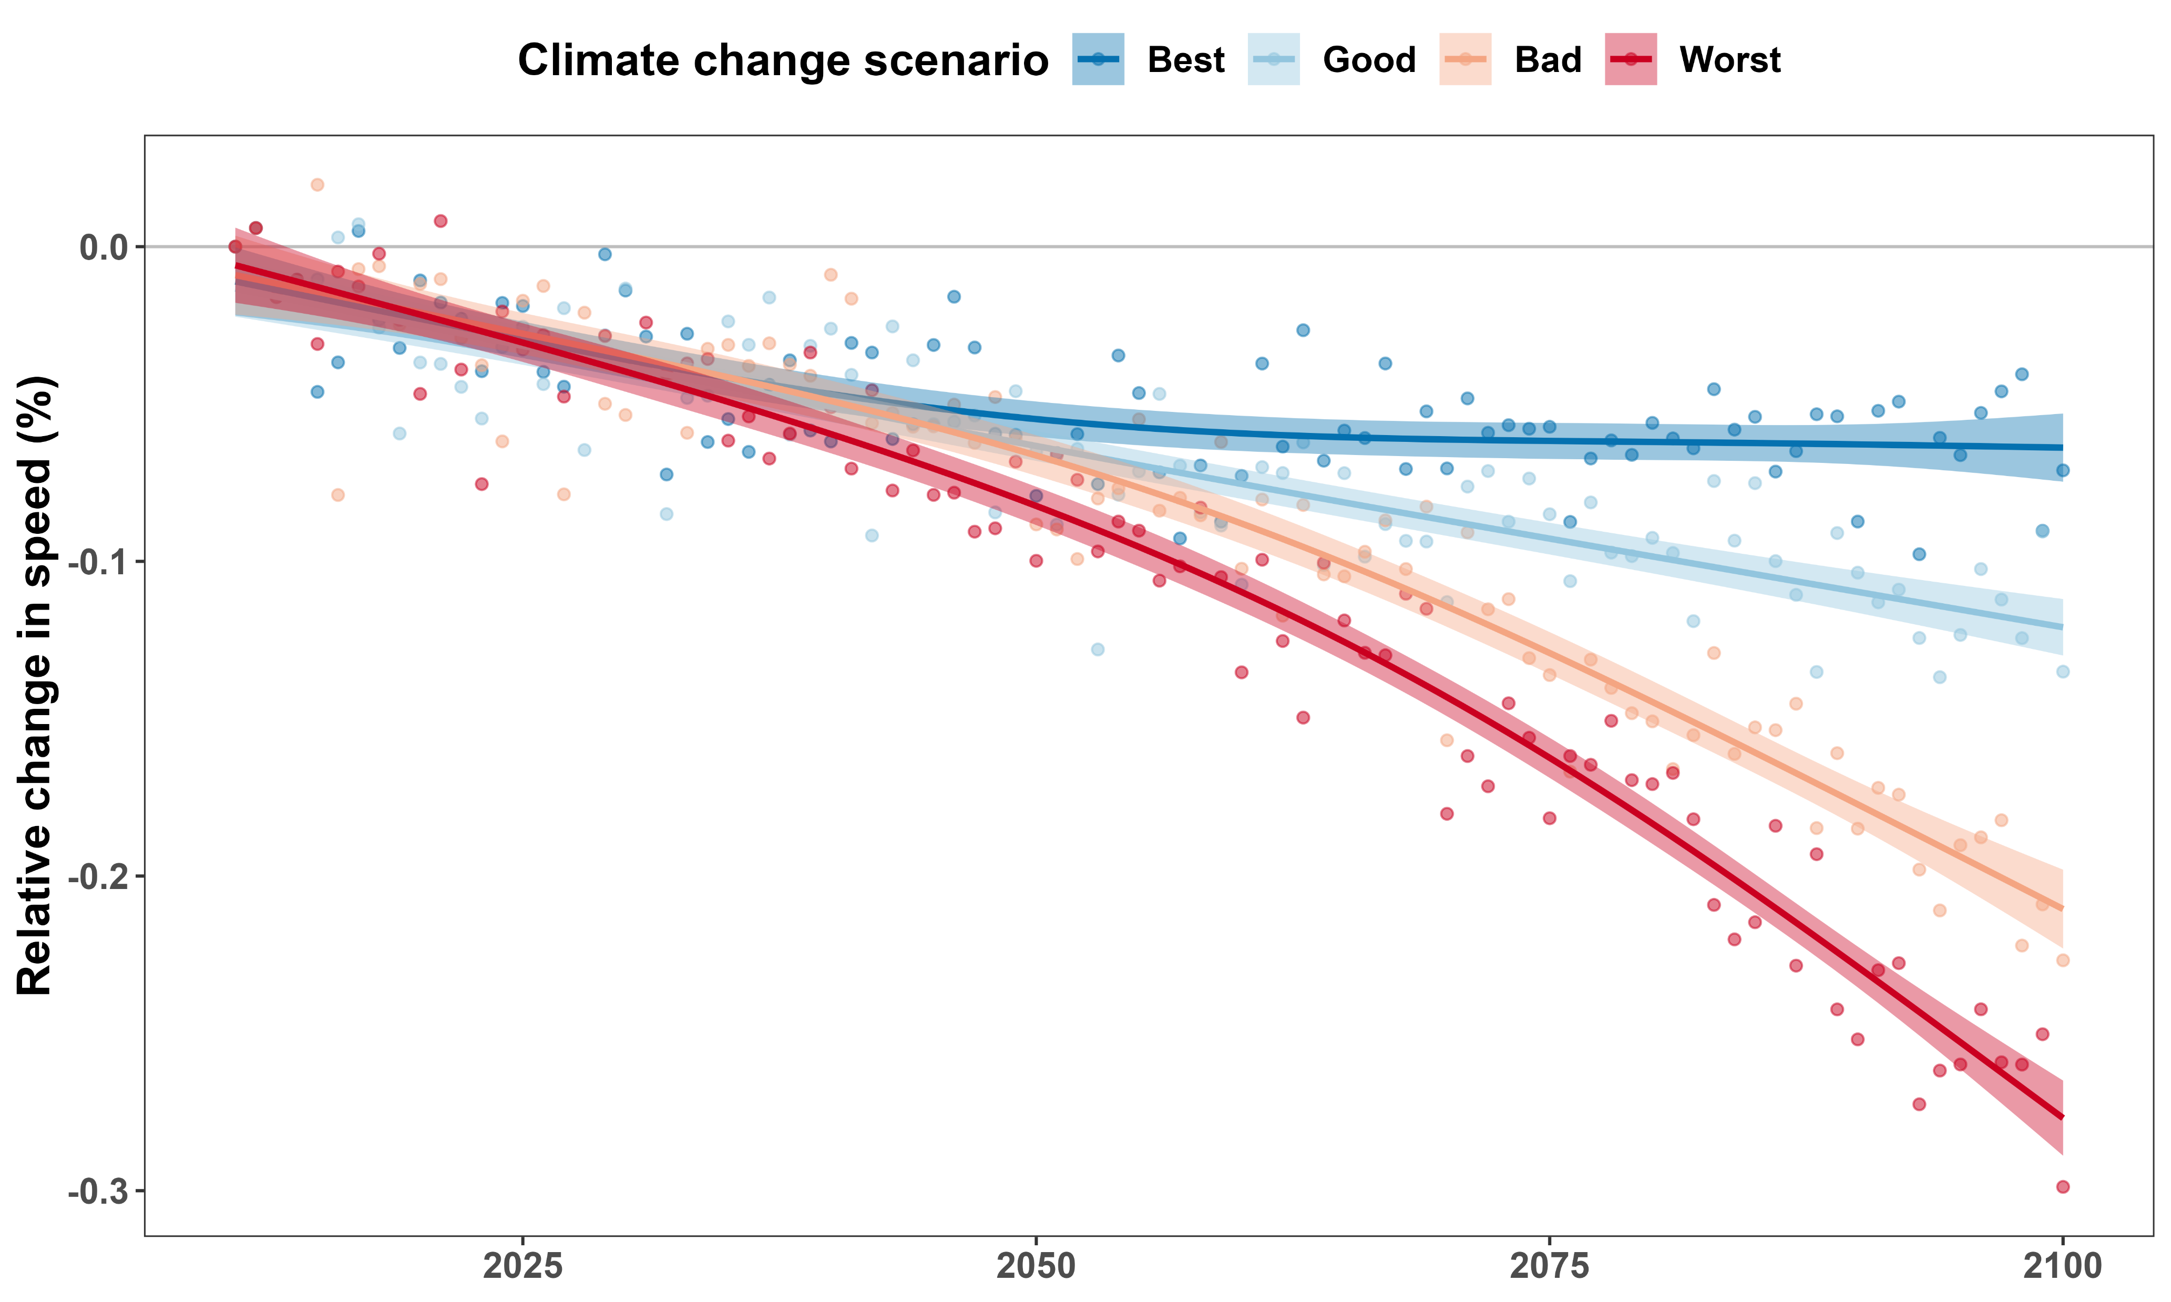
Boreal caribou will be moving a bit slower

Slide 21
How does temperature affect how far boreal caribou travel?

Slide 22

Calculating distance travelled
$$×$$
$P\left(moving\right)$ $×$ $\left(speed | moving\right)×Δt$

Slide 23
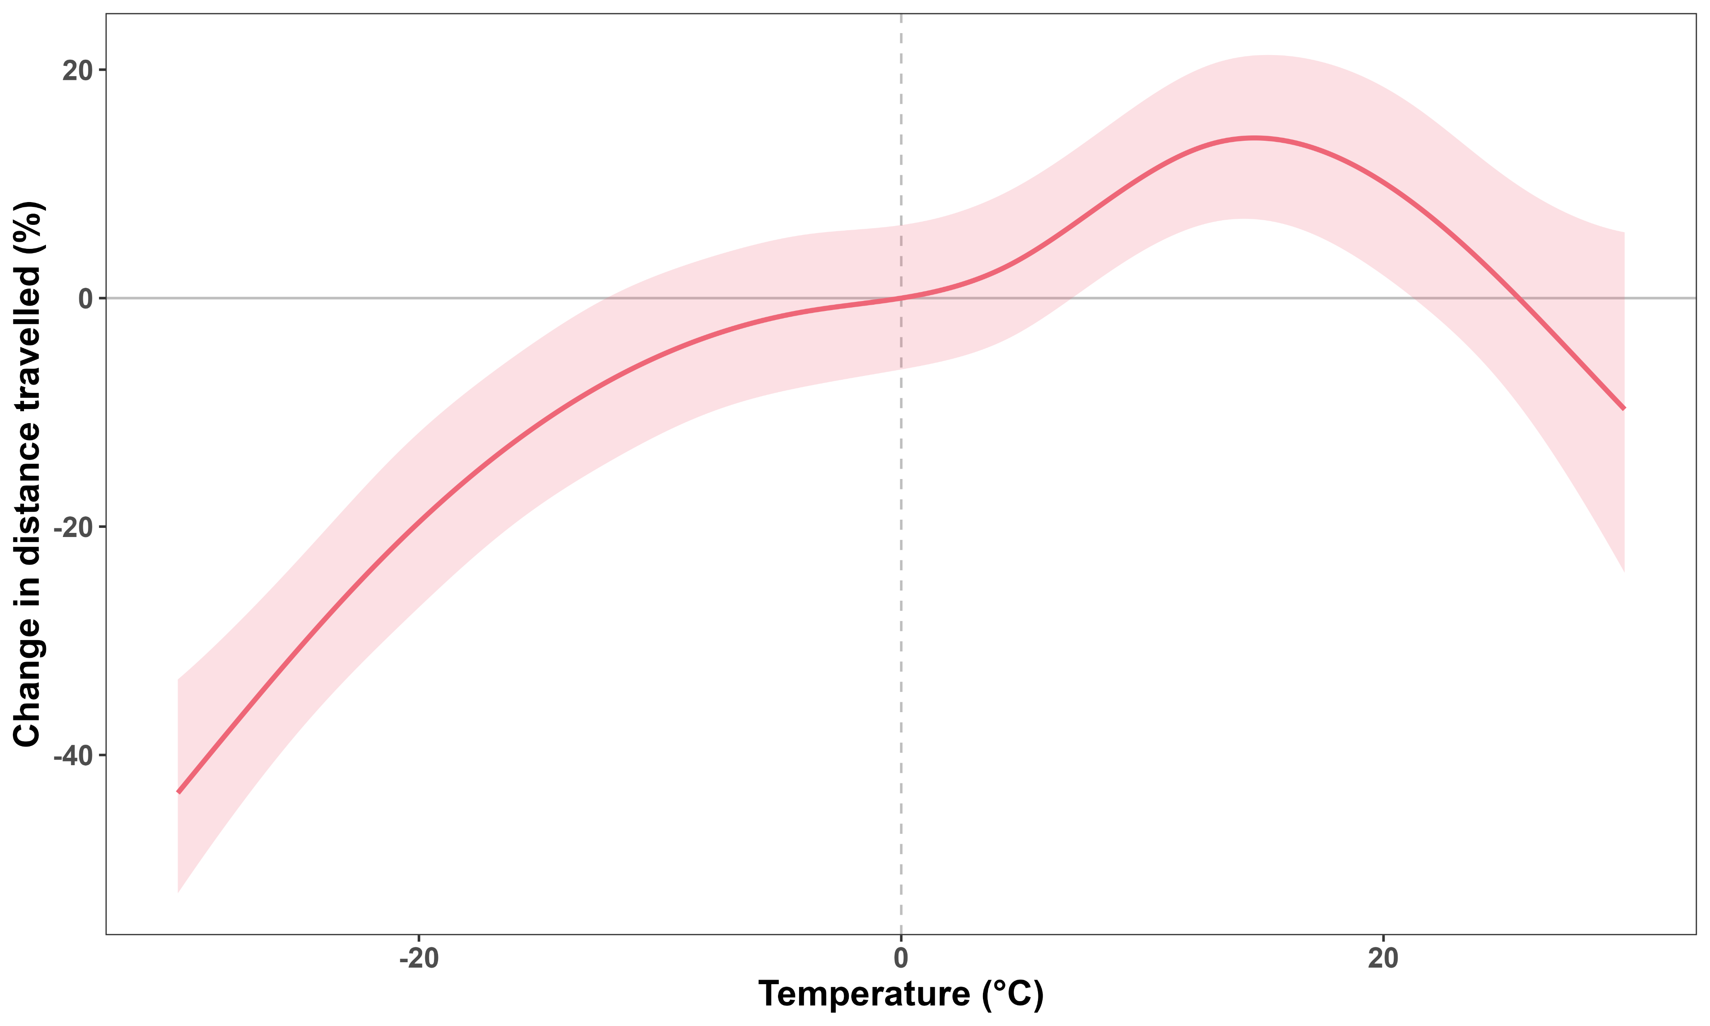
Caribou travel further at warmer temperatures

Slide 24
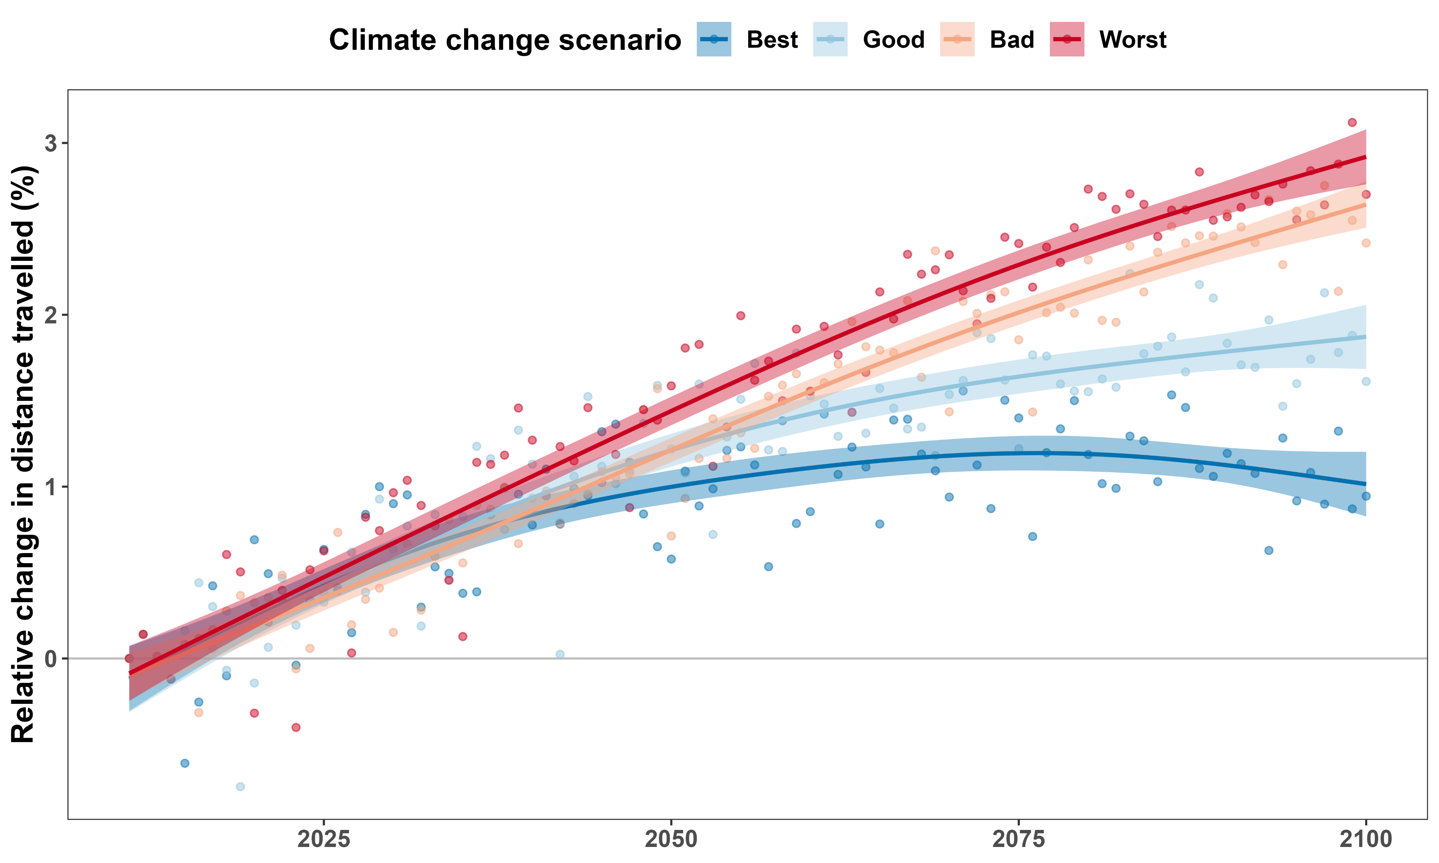
Boreal caribou will travel a bit more

Slide 25
Temperature and habitat selection

Slide 26
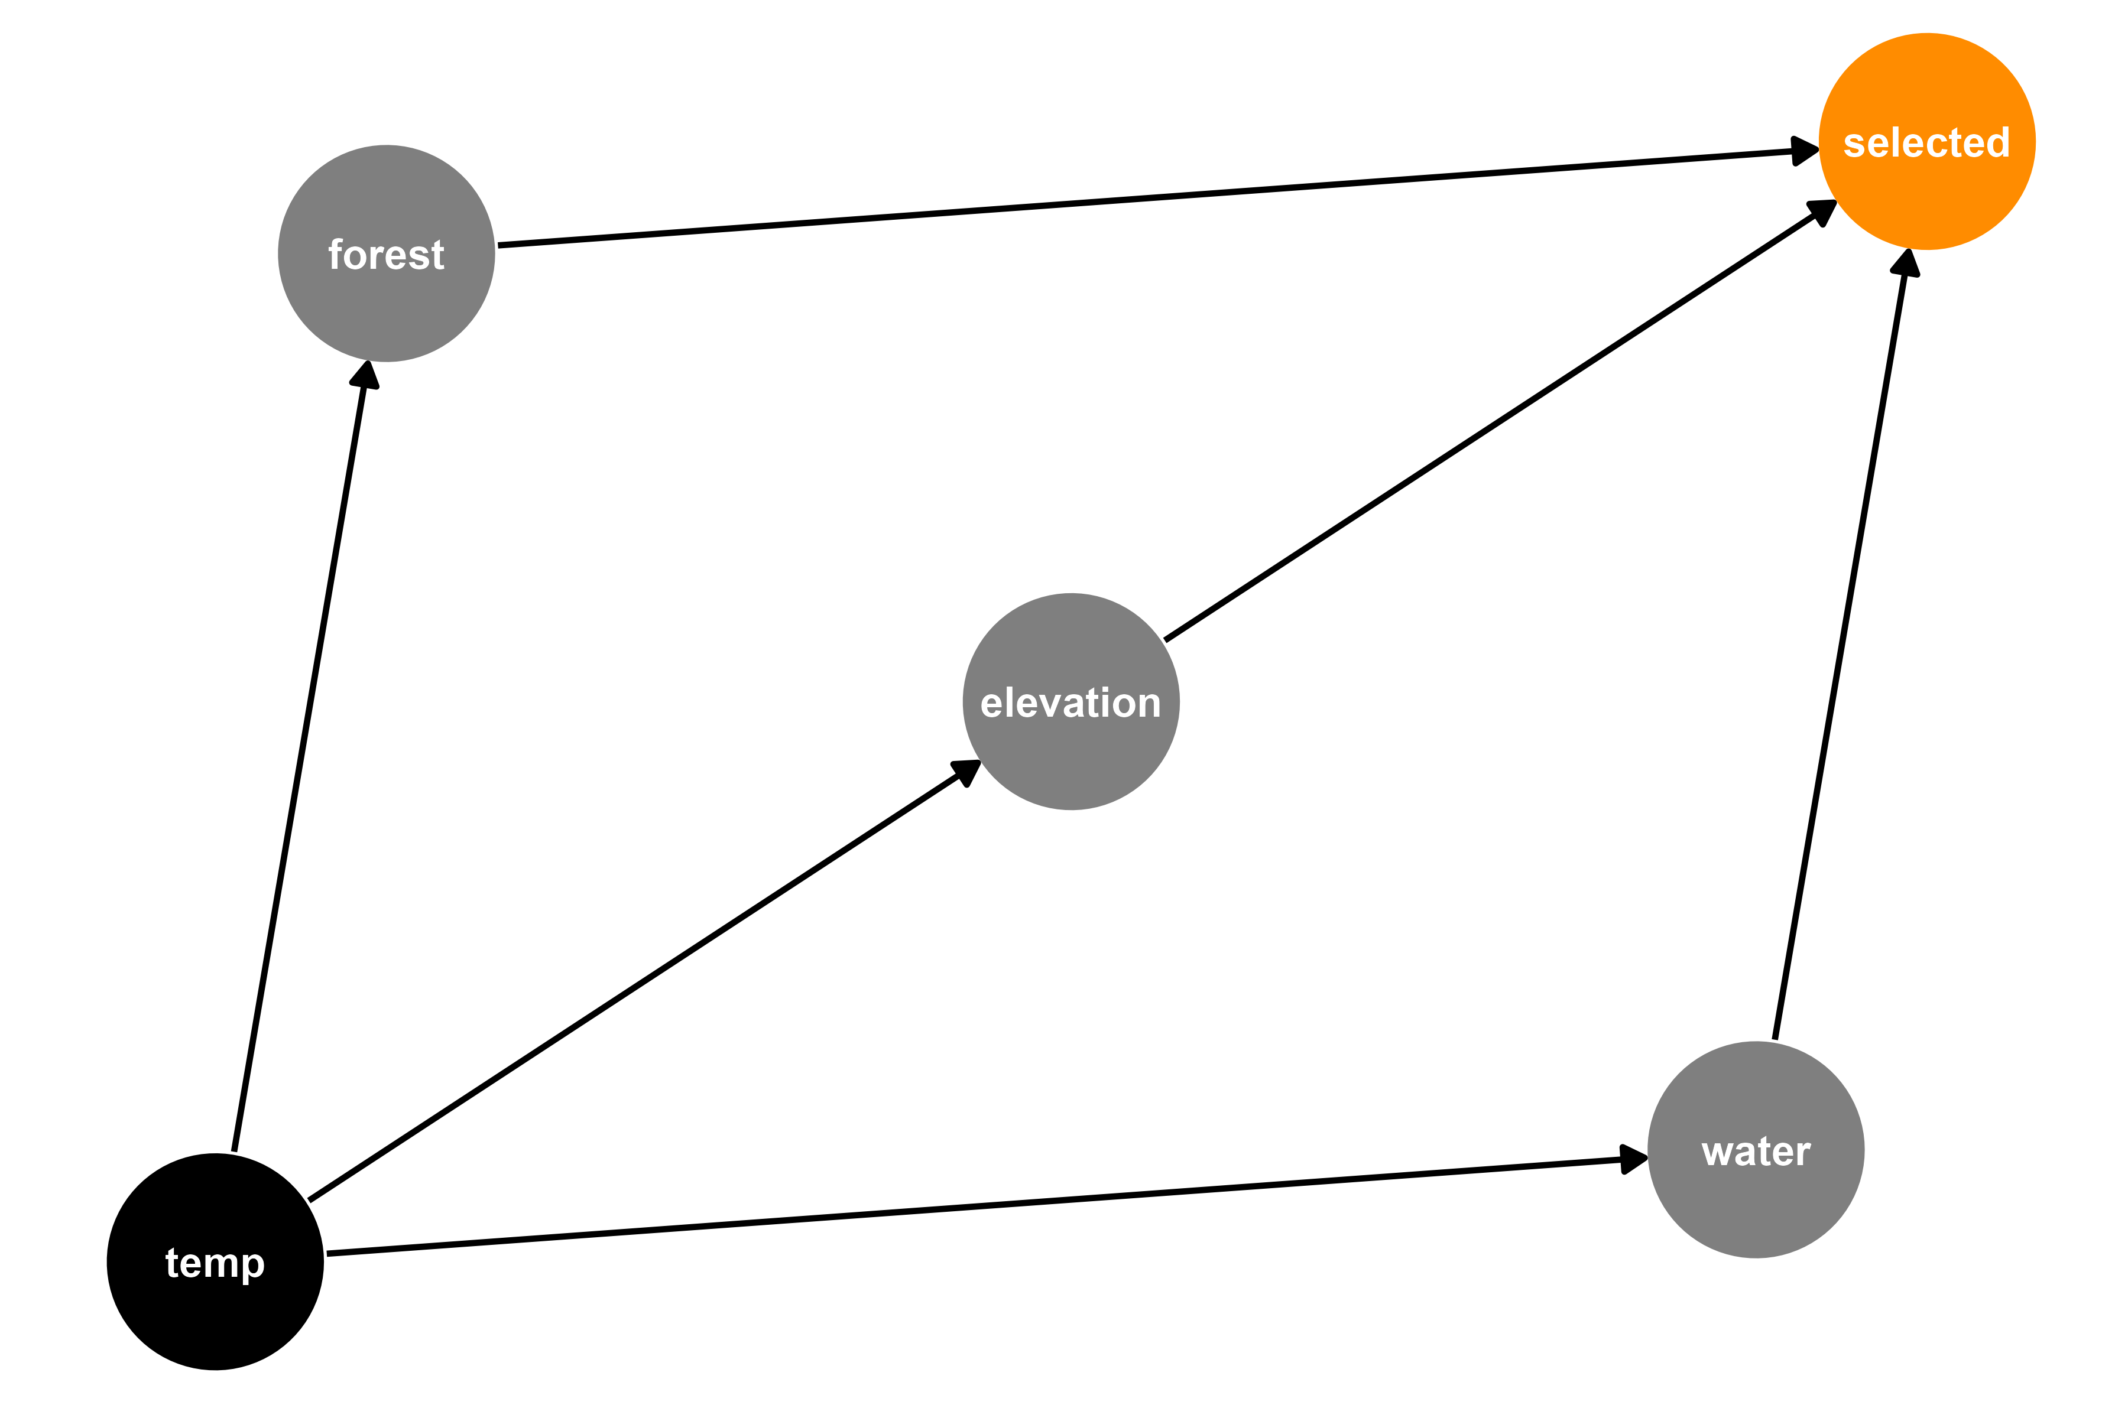



Modeling where boreal caribou move: Resource Selection Function (RSF)

Slide 27
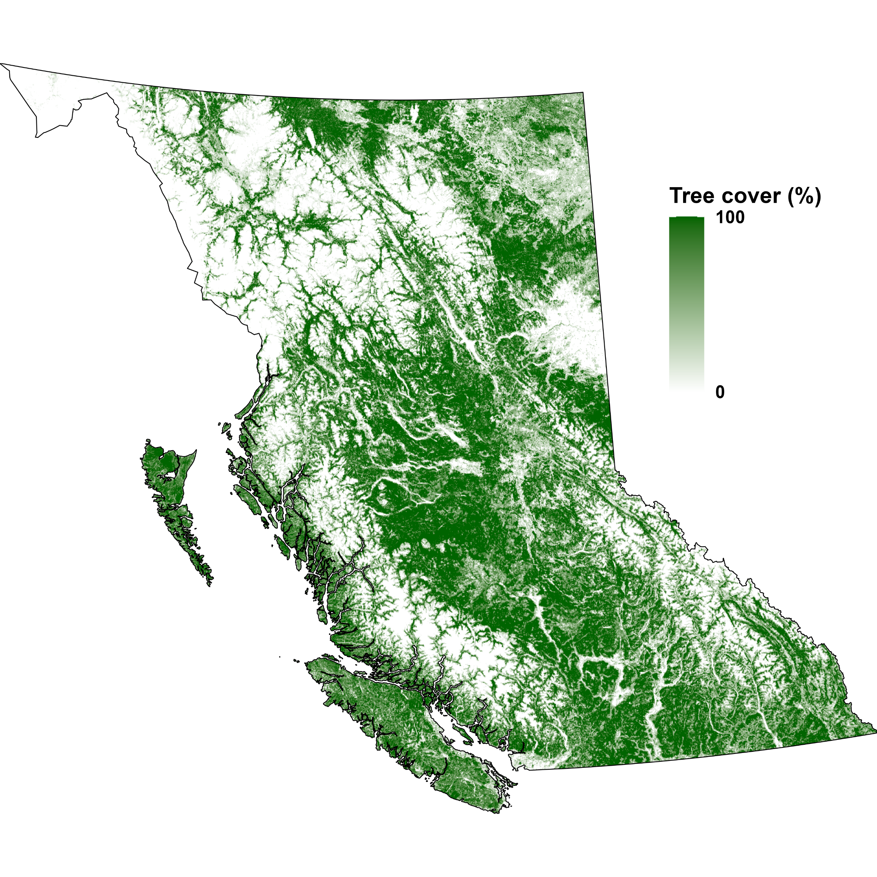
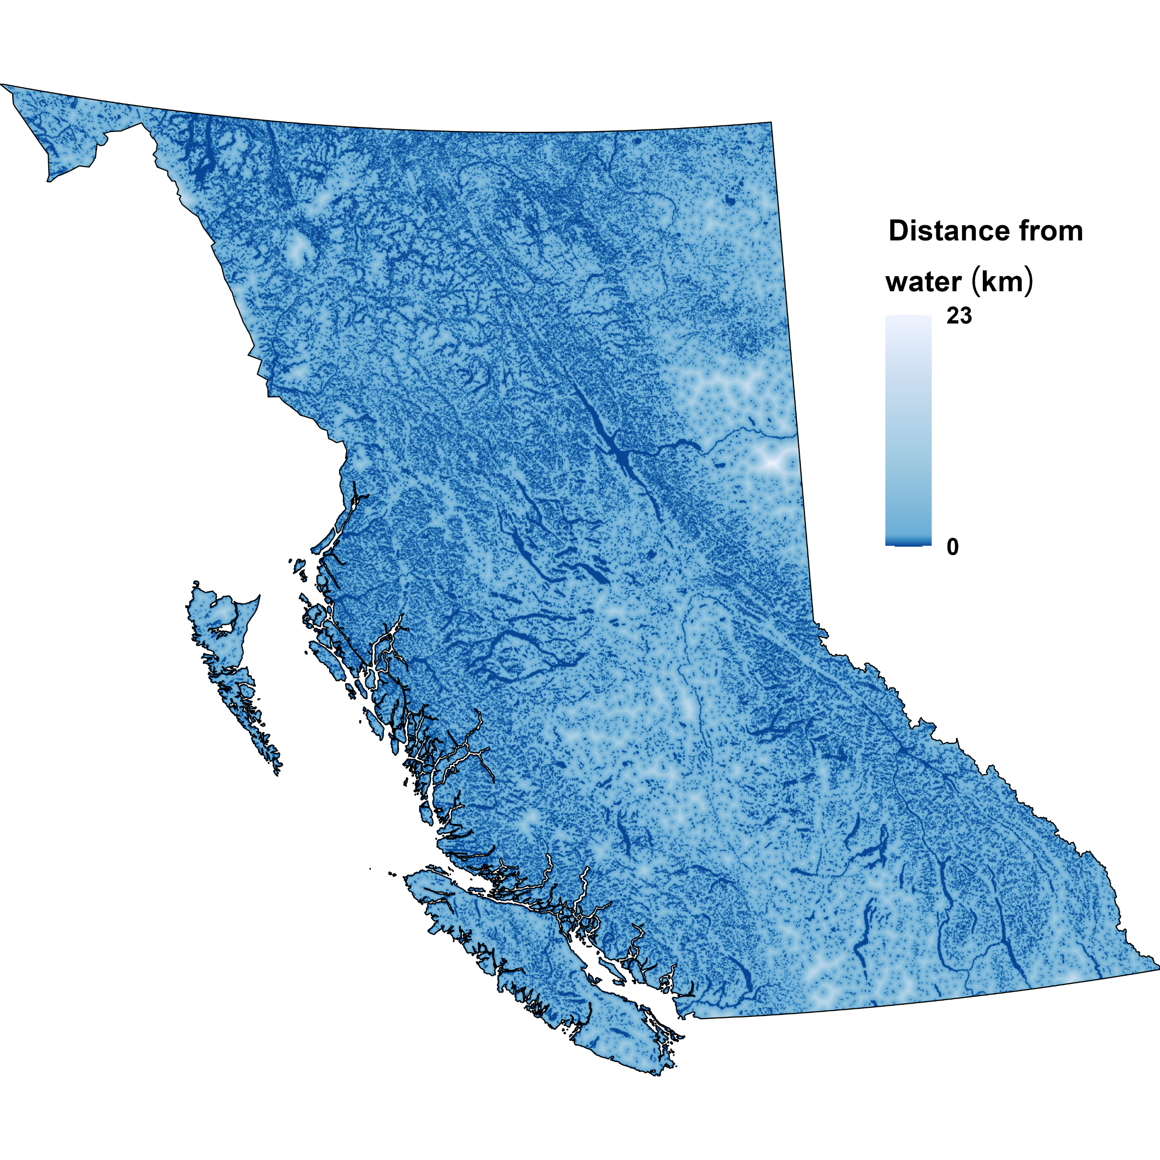
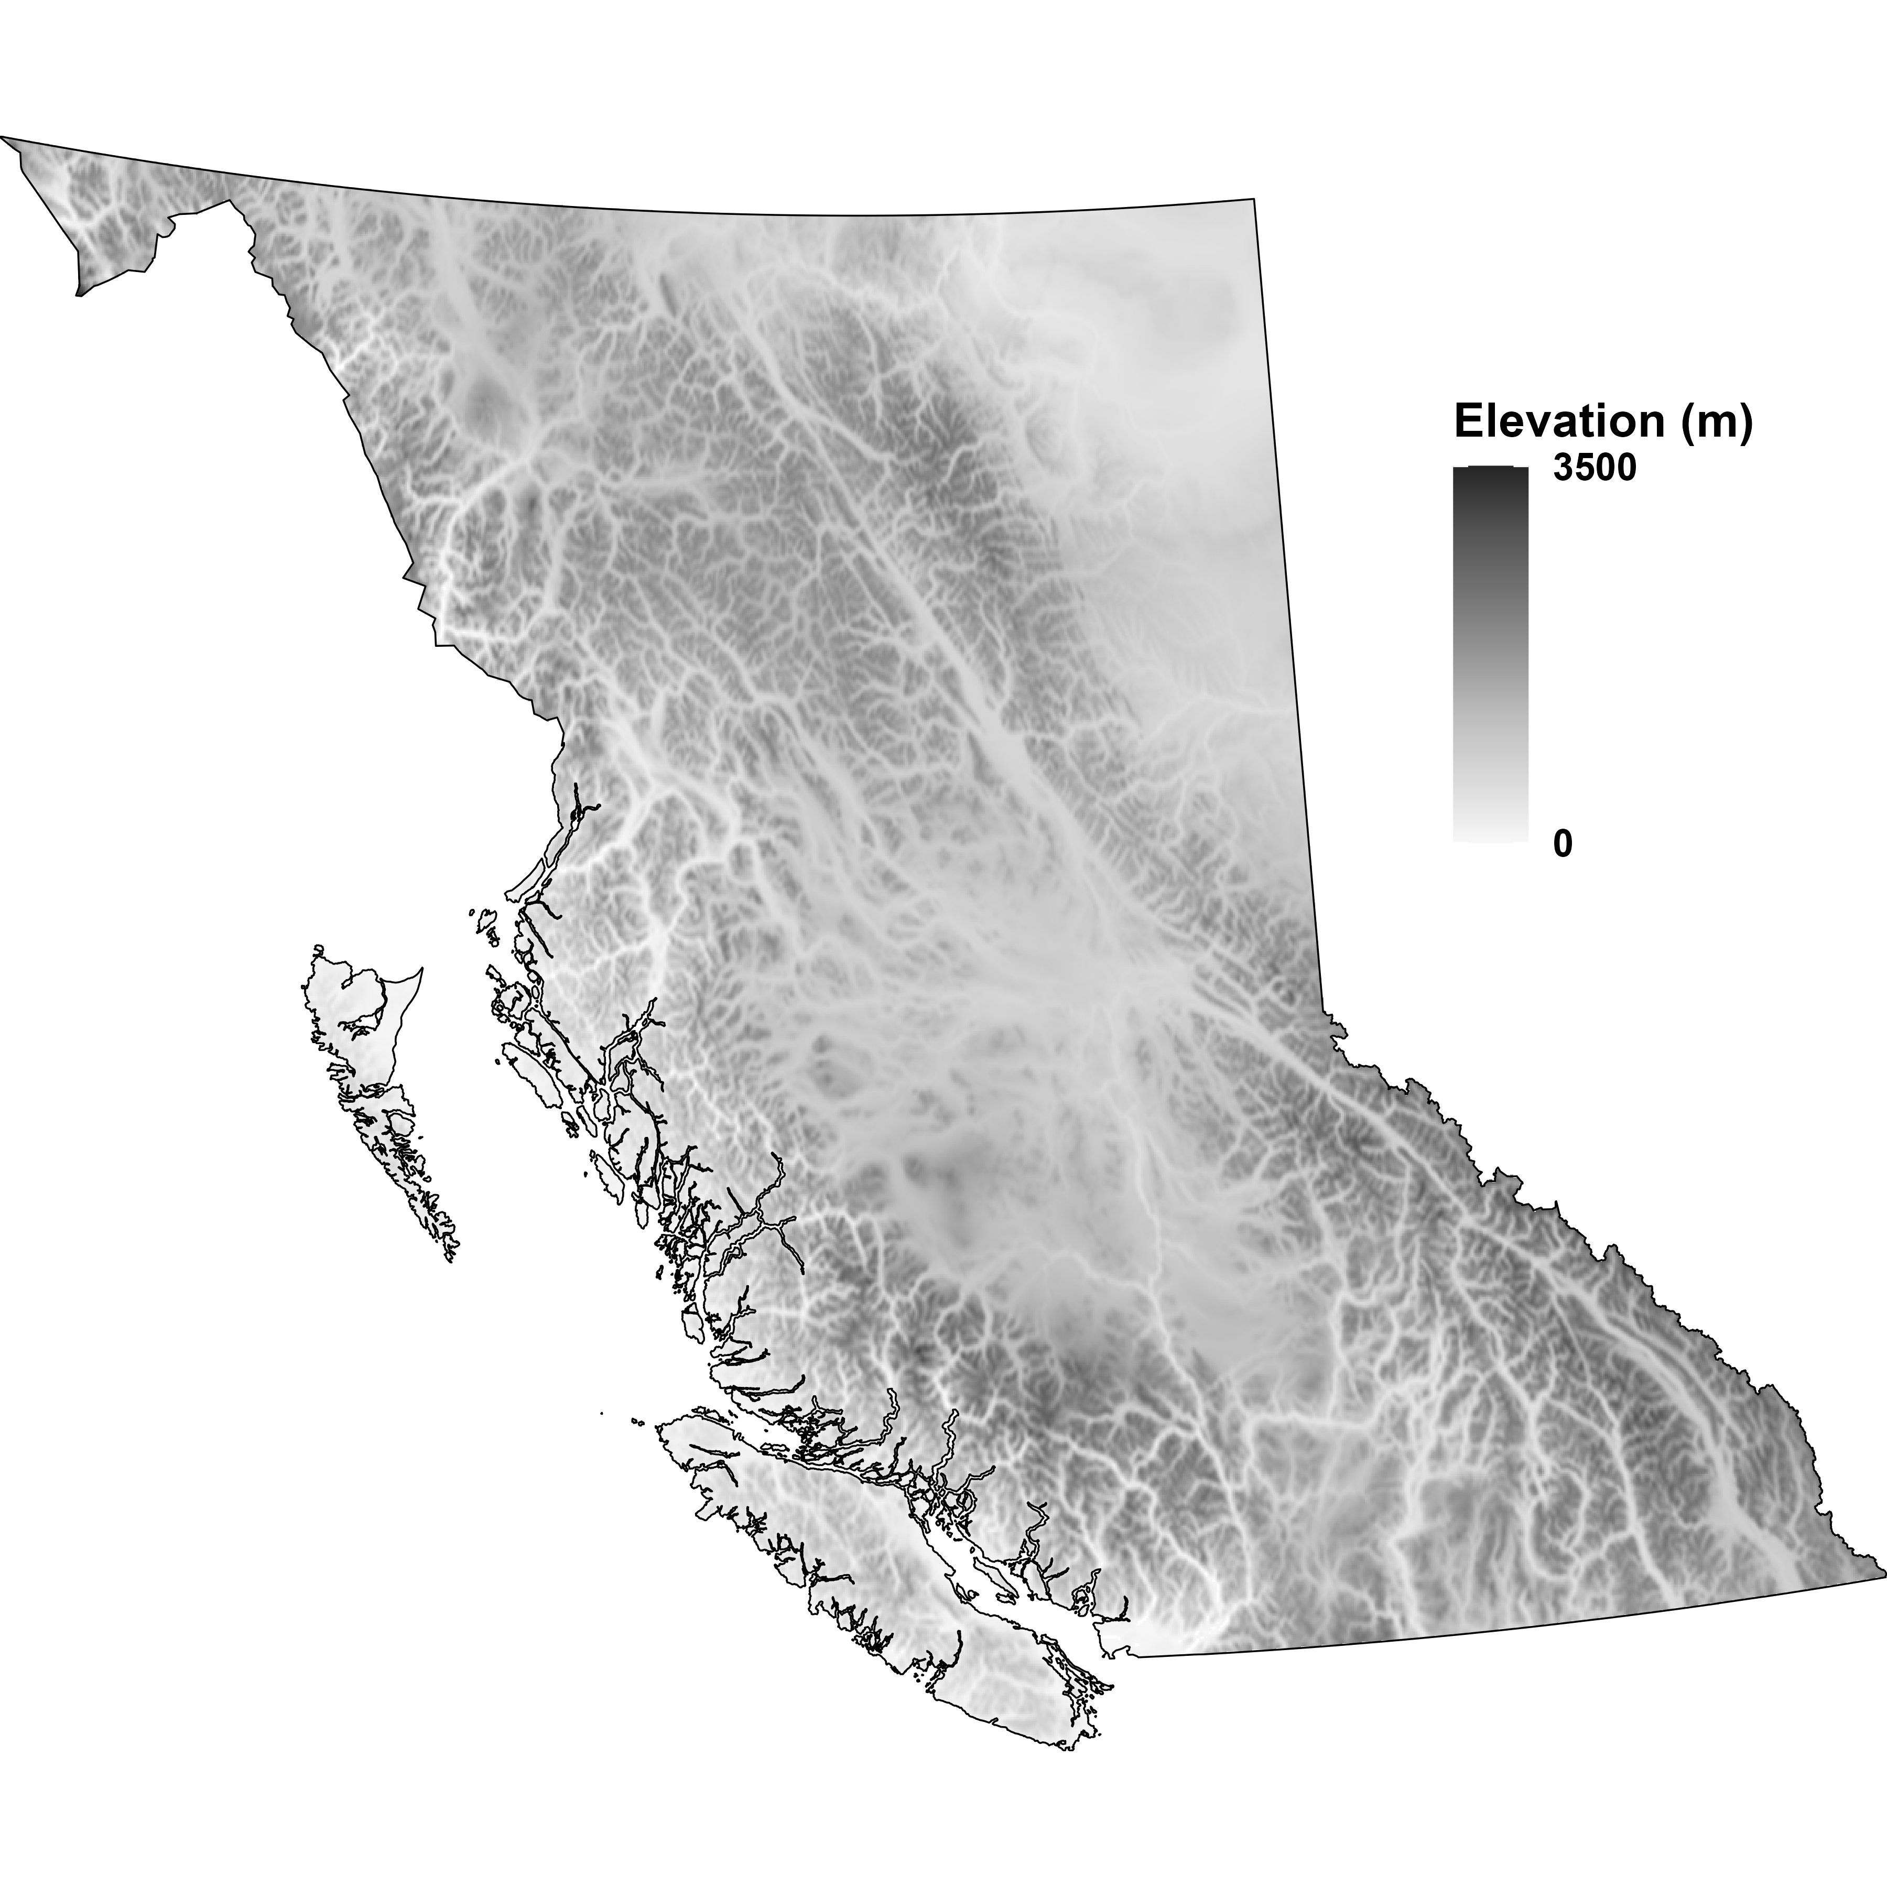

Slide 28
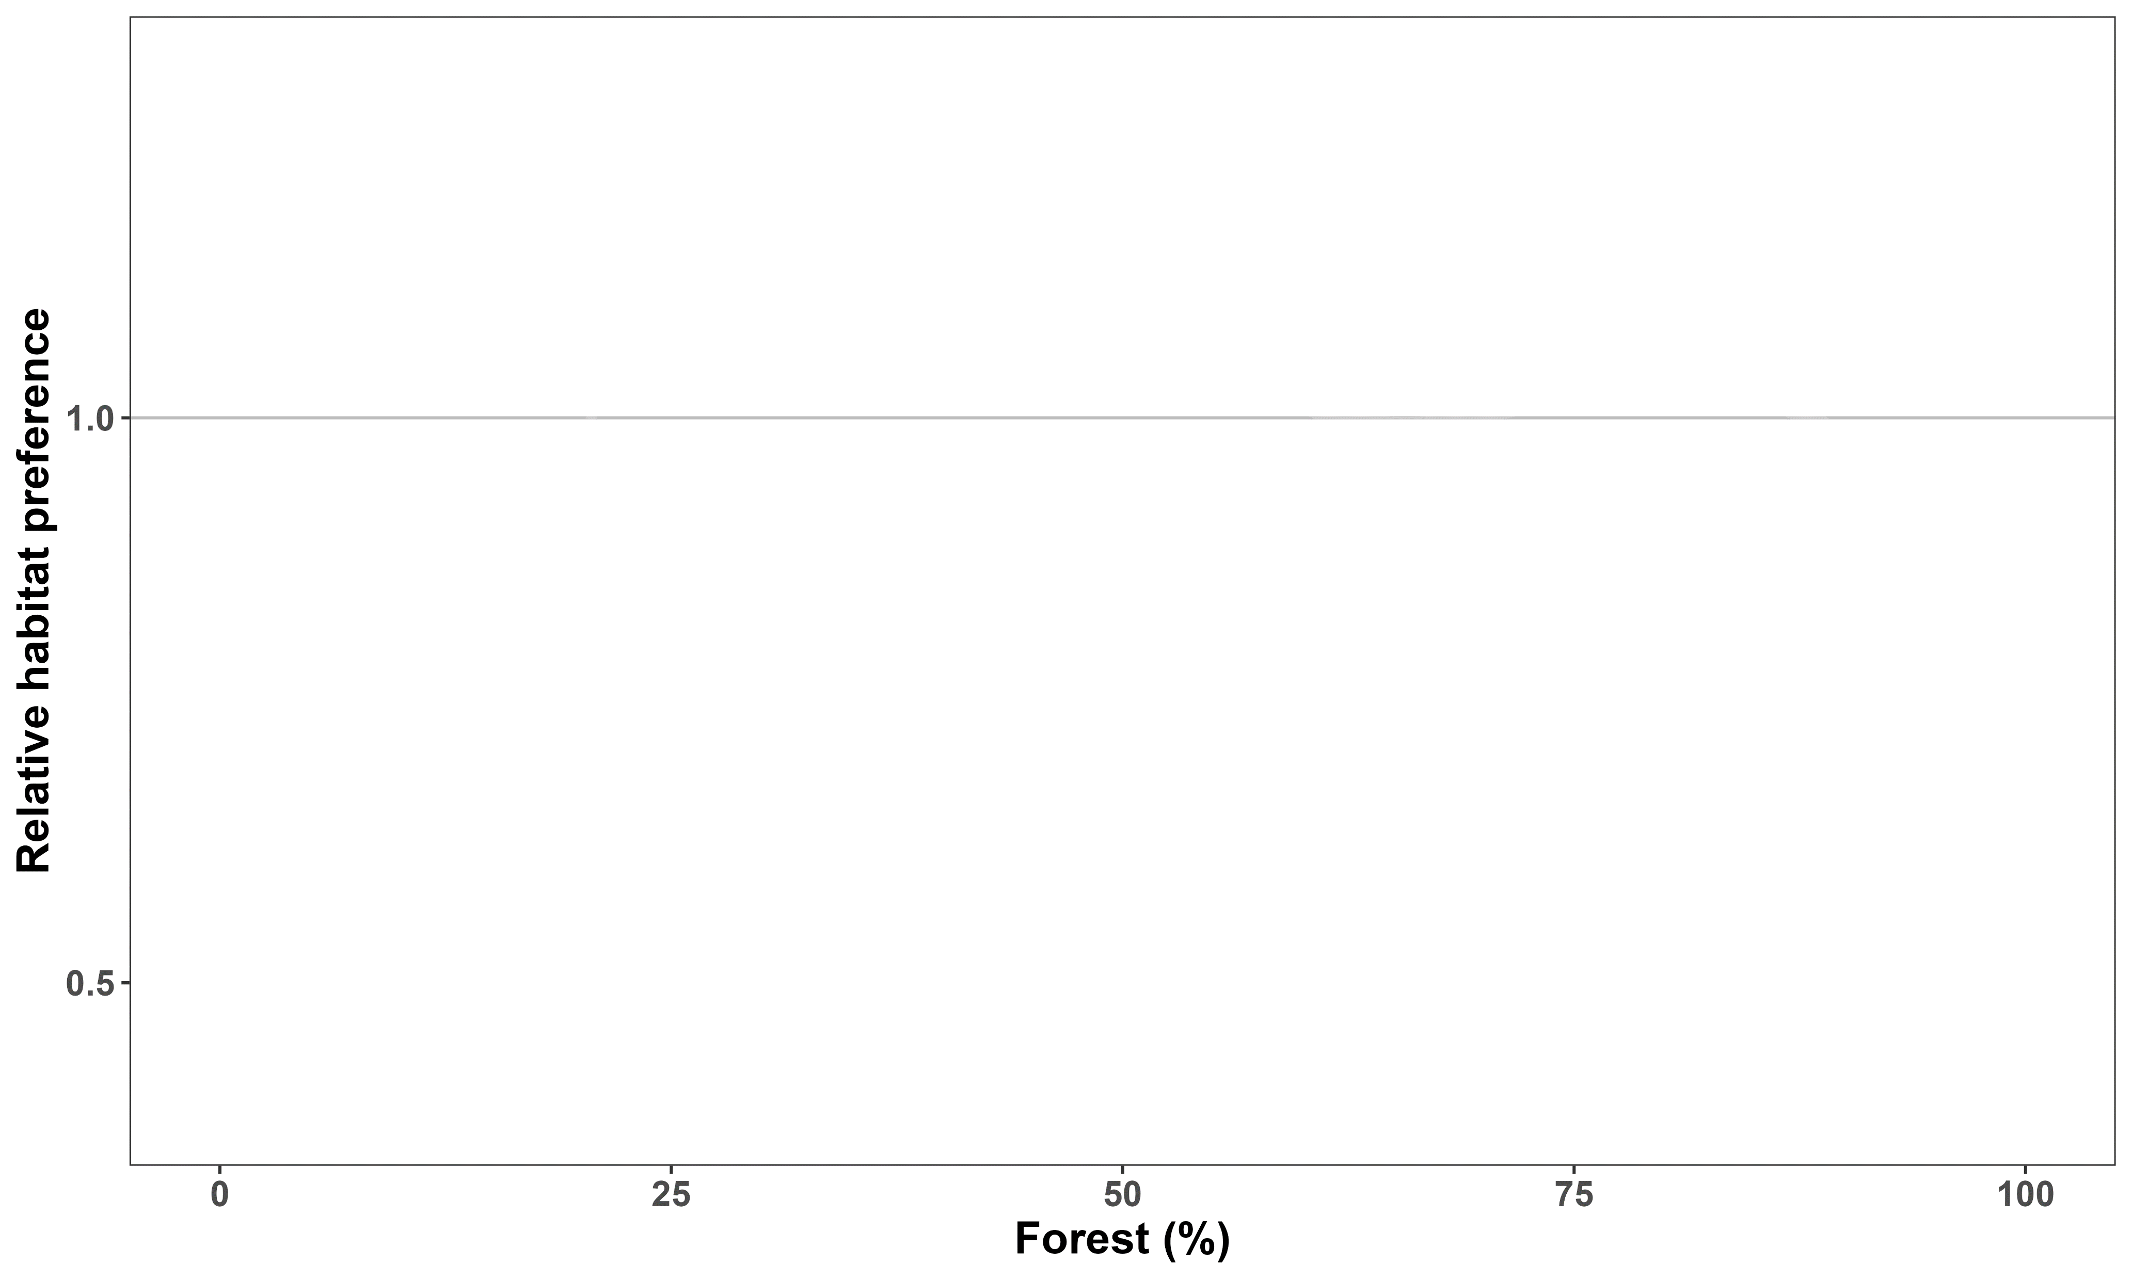

Boreal caribou prefer intermediate forest cover
Like
Dislike

Slide 29
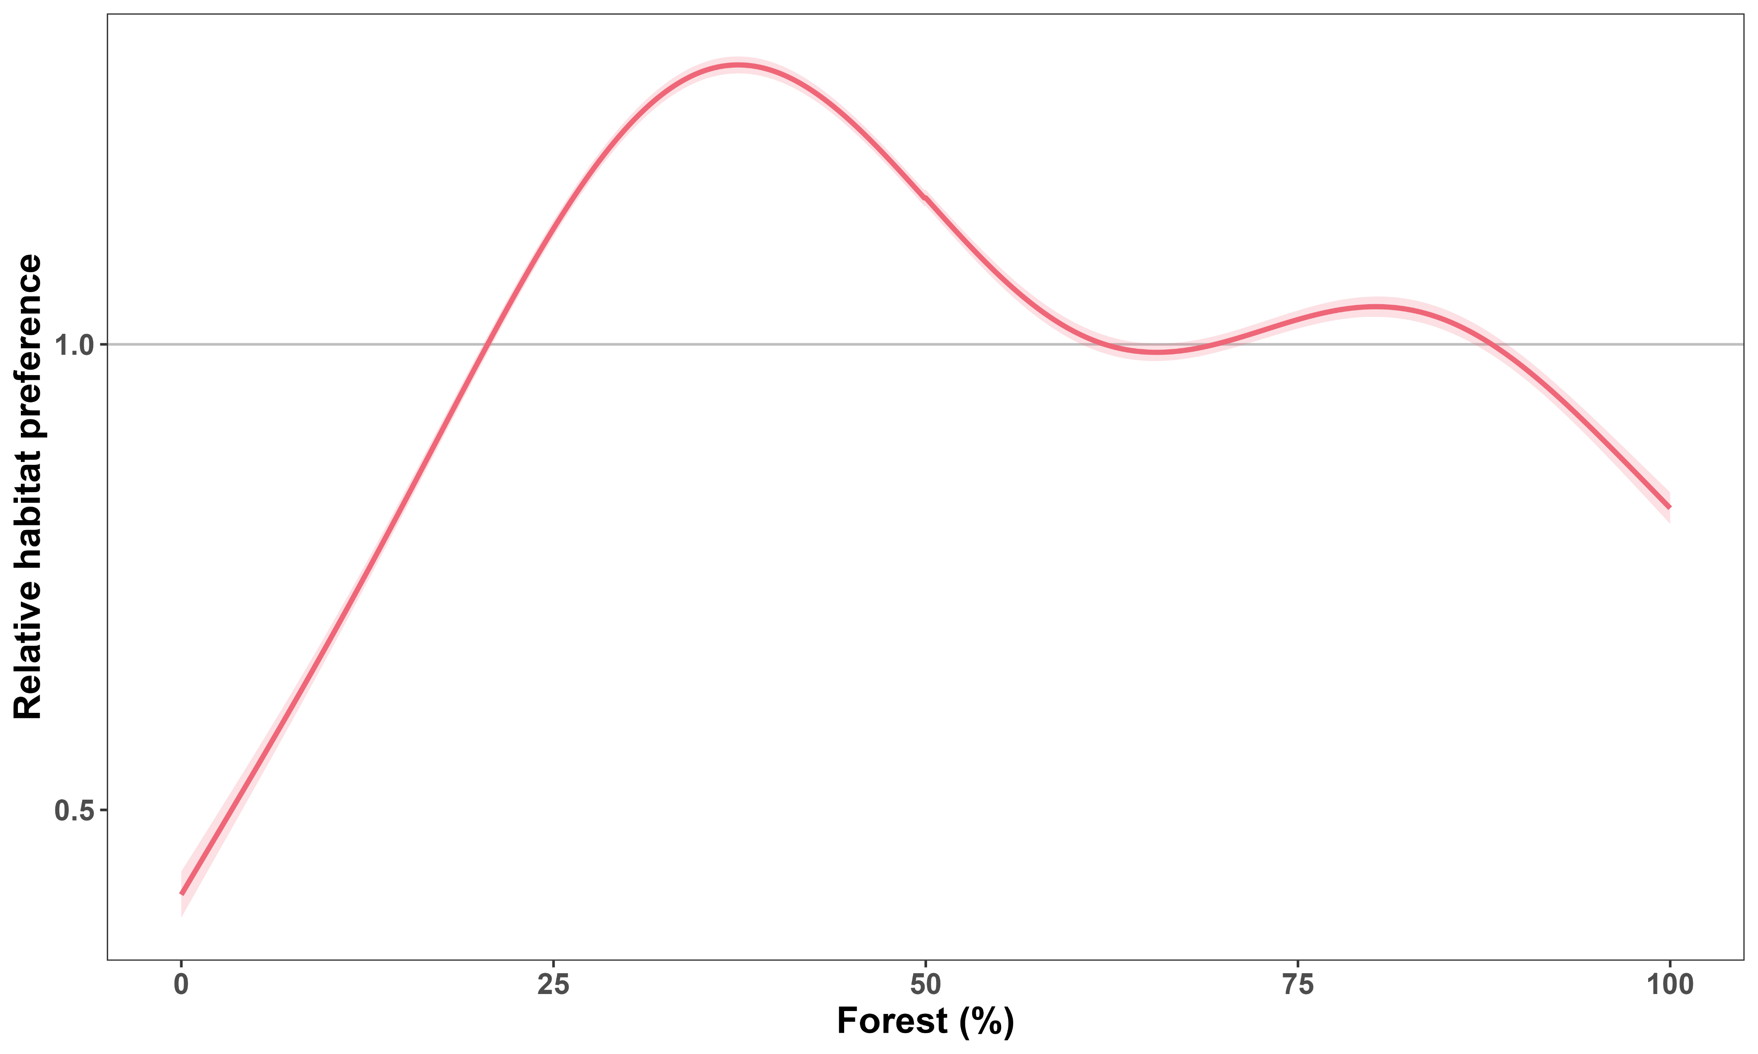
Boreal caribou prefer intermediate forest cover
Like
Dislike

Slide 30
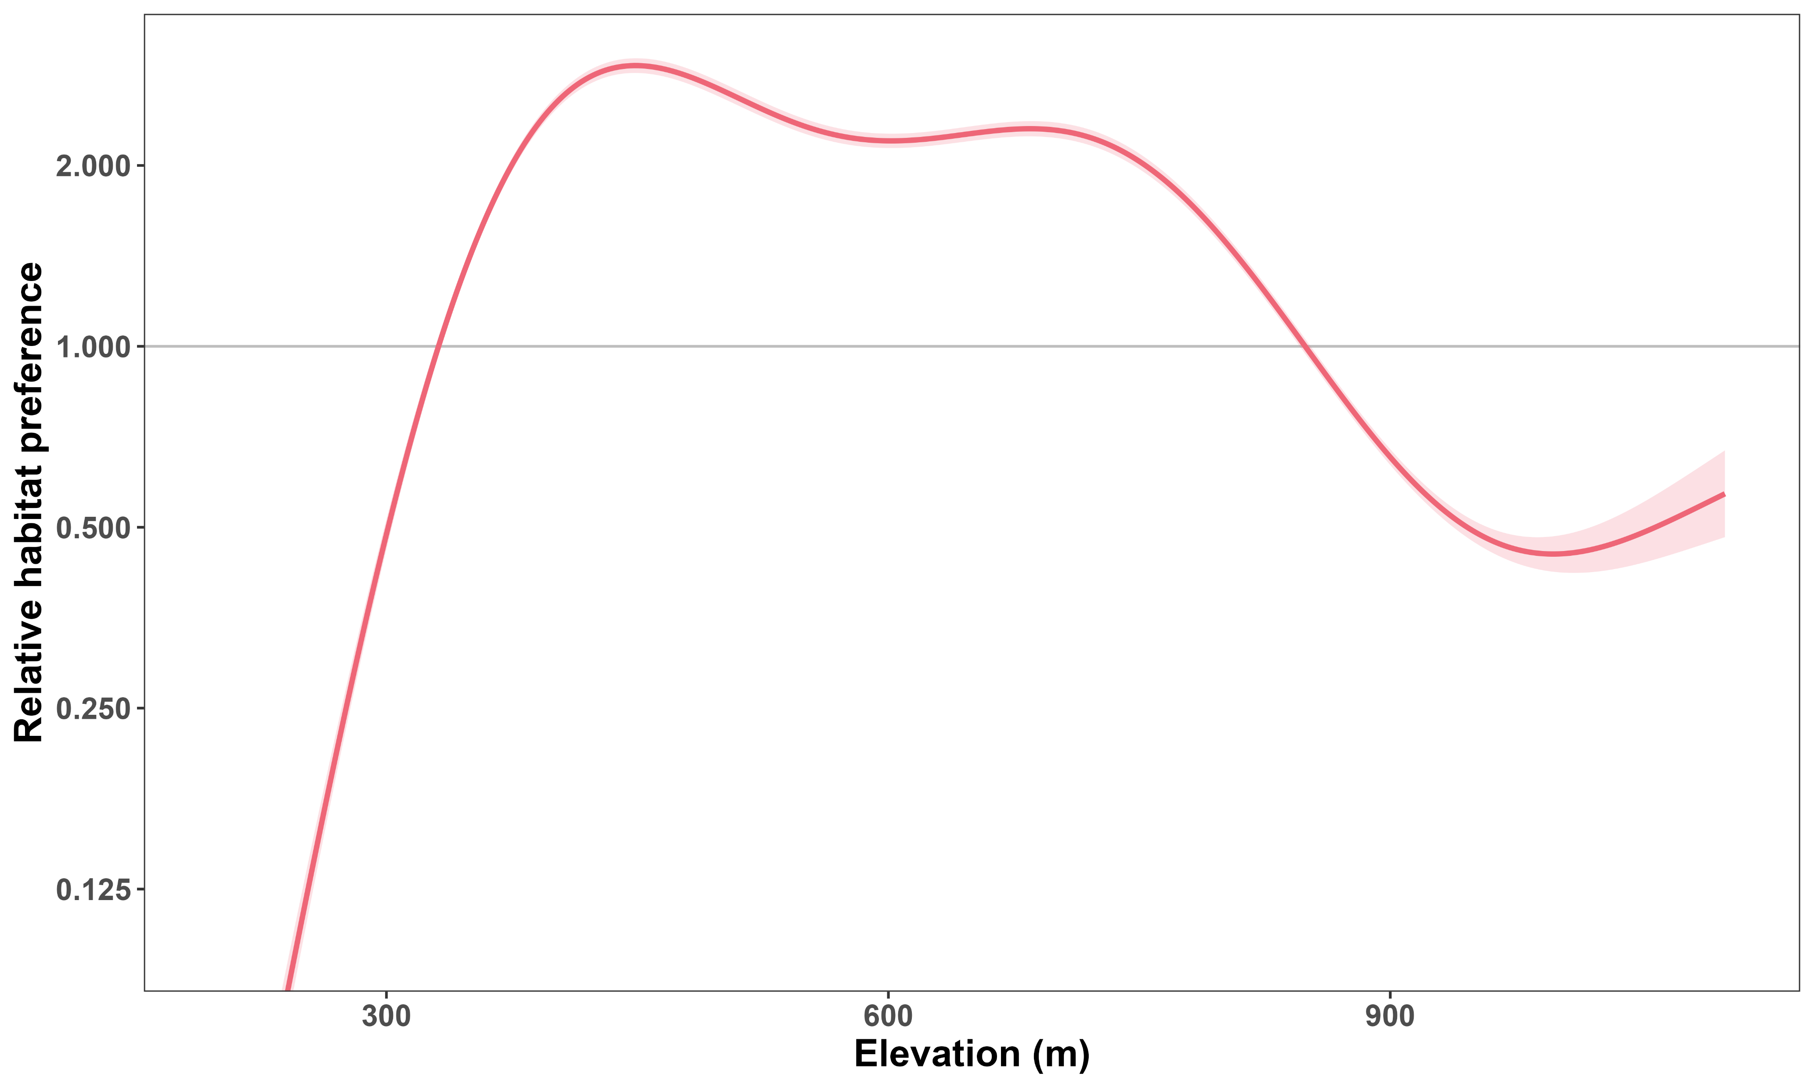

Boreal caribou prefer lower elevations
Like
Dislike

Slide 31
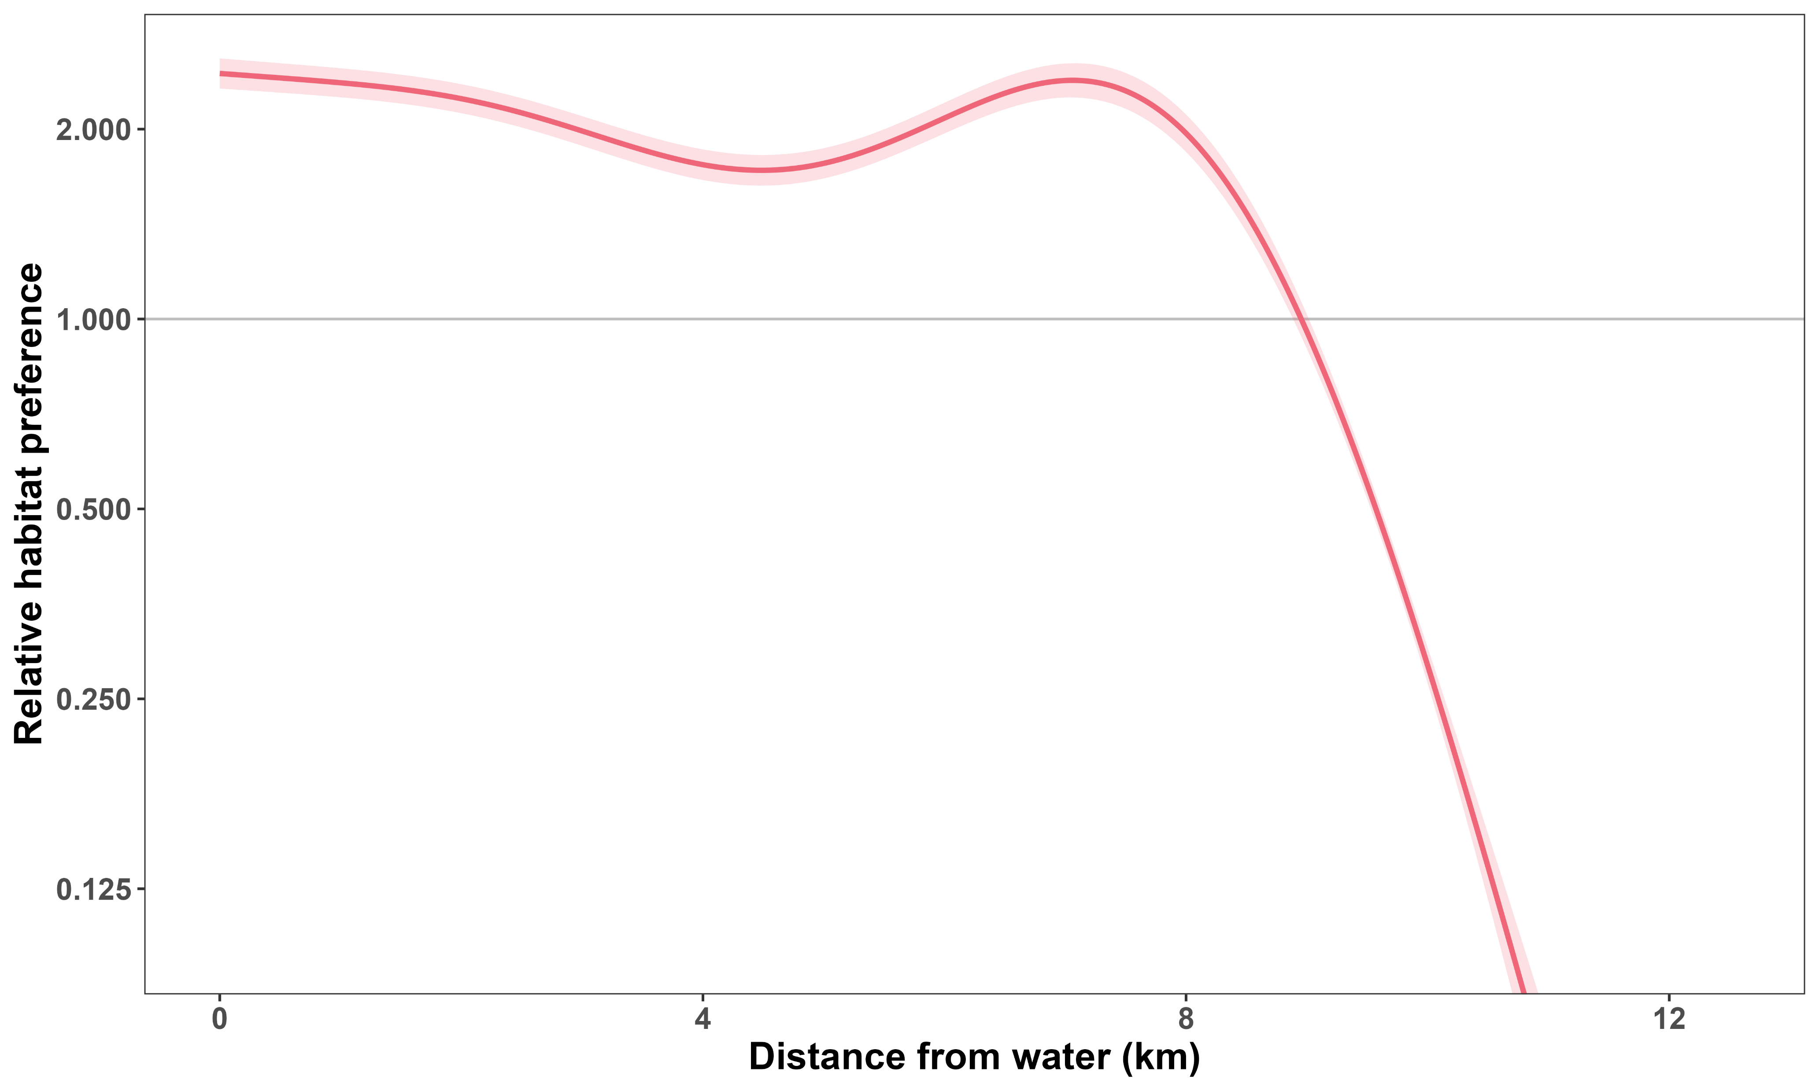

Boreal caribou prefer being near water
Like
Dislike

Slide 32


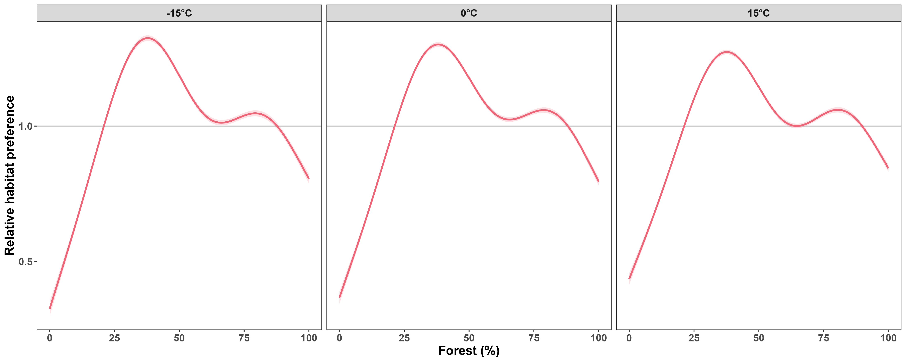
Forest preference is weaker at warmer temperatures

Slide 33
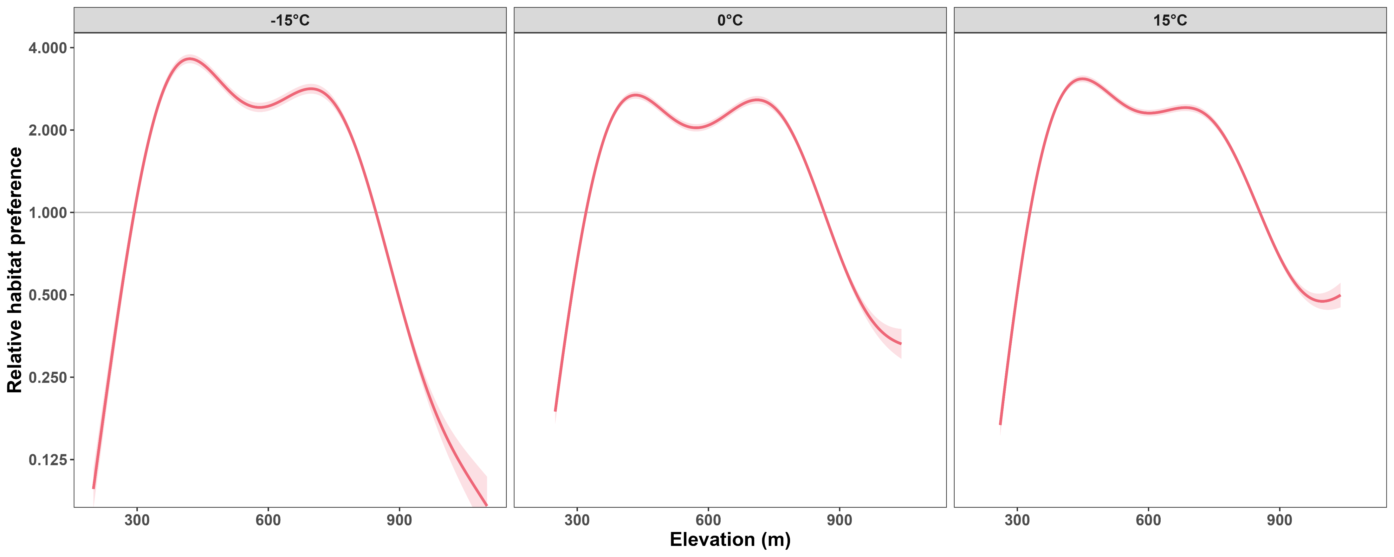
Elevation preference is weaker at warmer temperatures

Slide 34
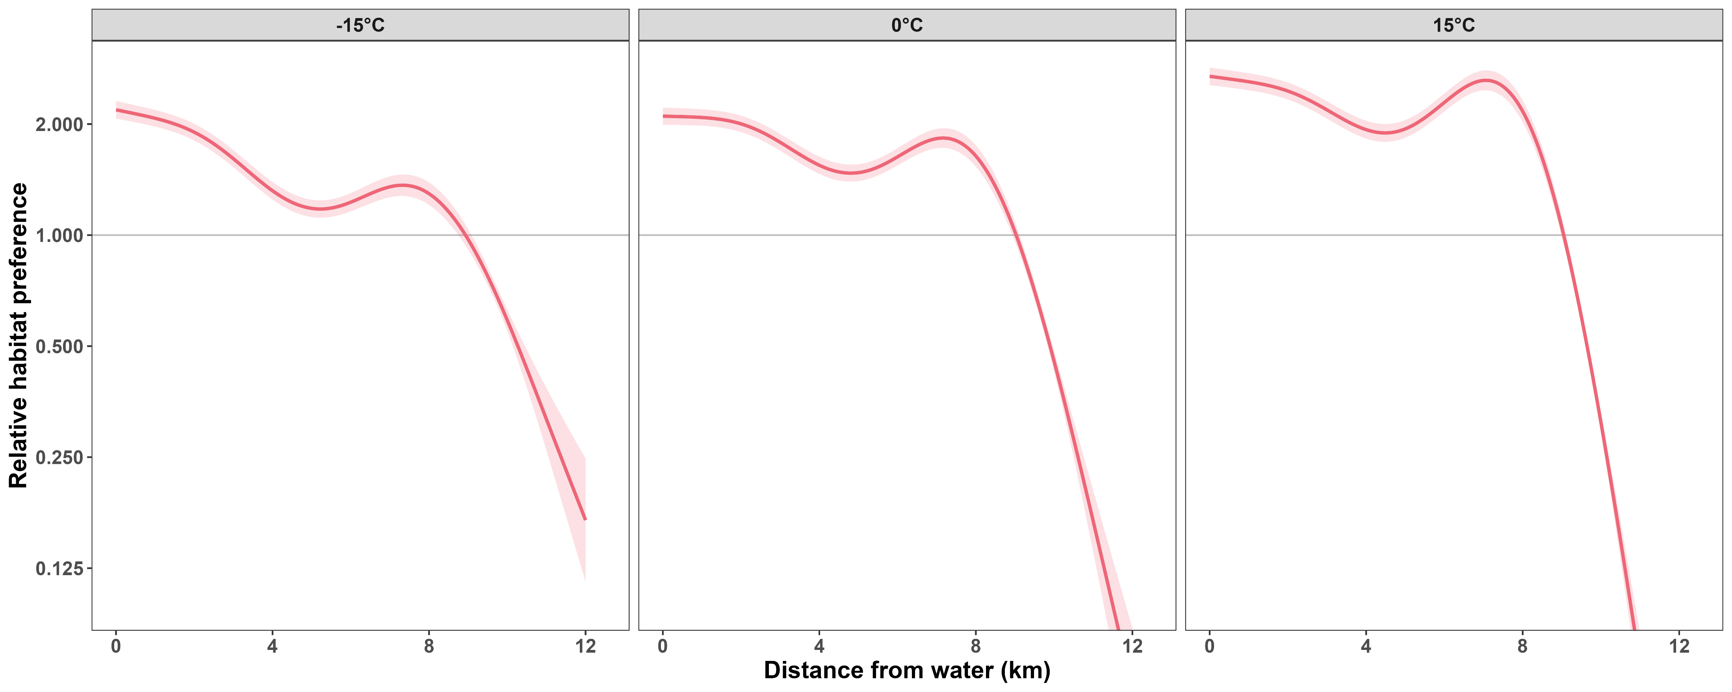
Boreal caribou stay closer to water at warmer temperatures

Slide 35
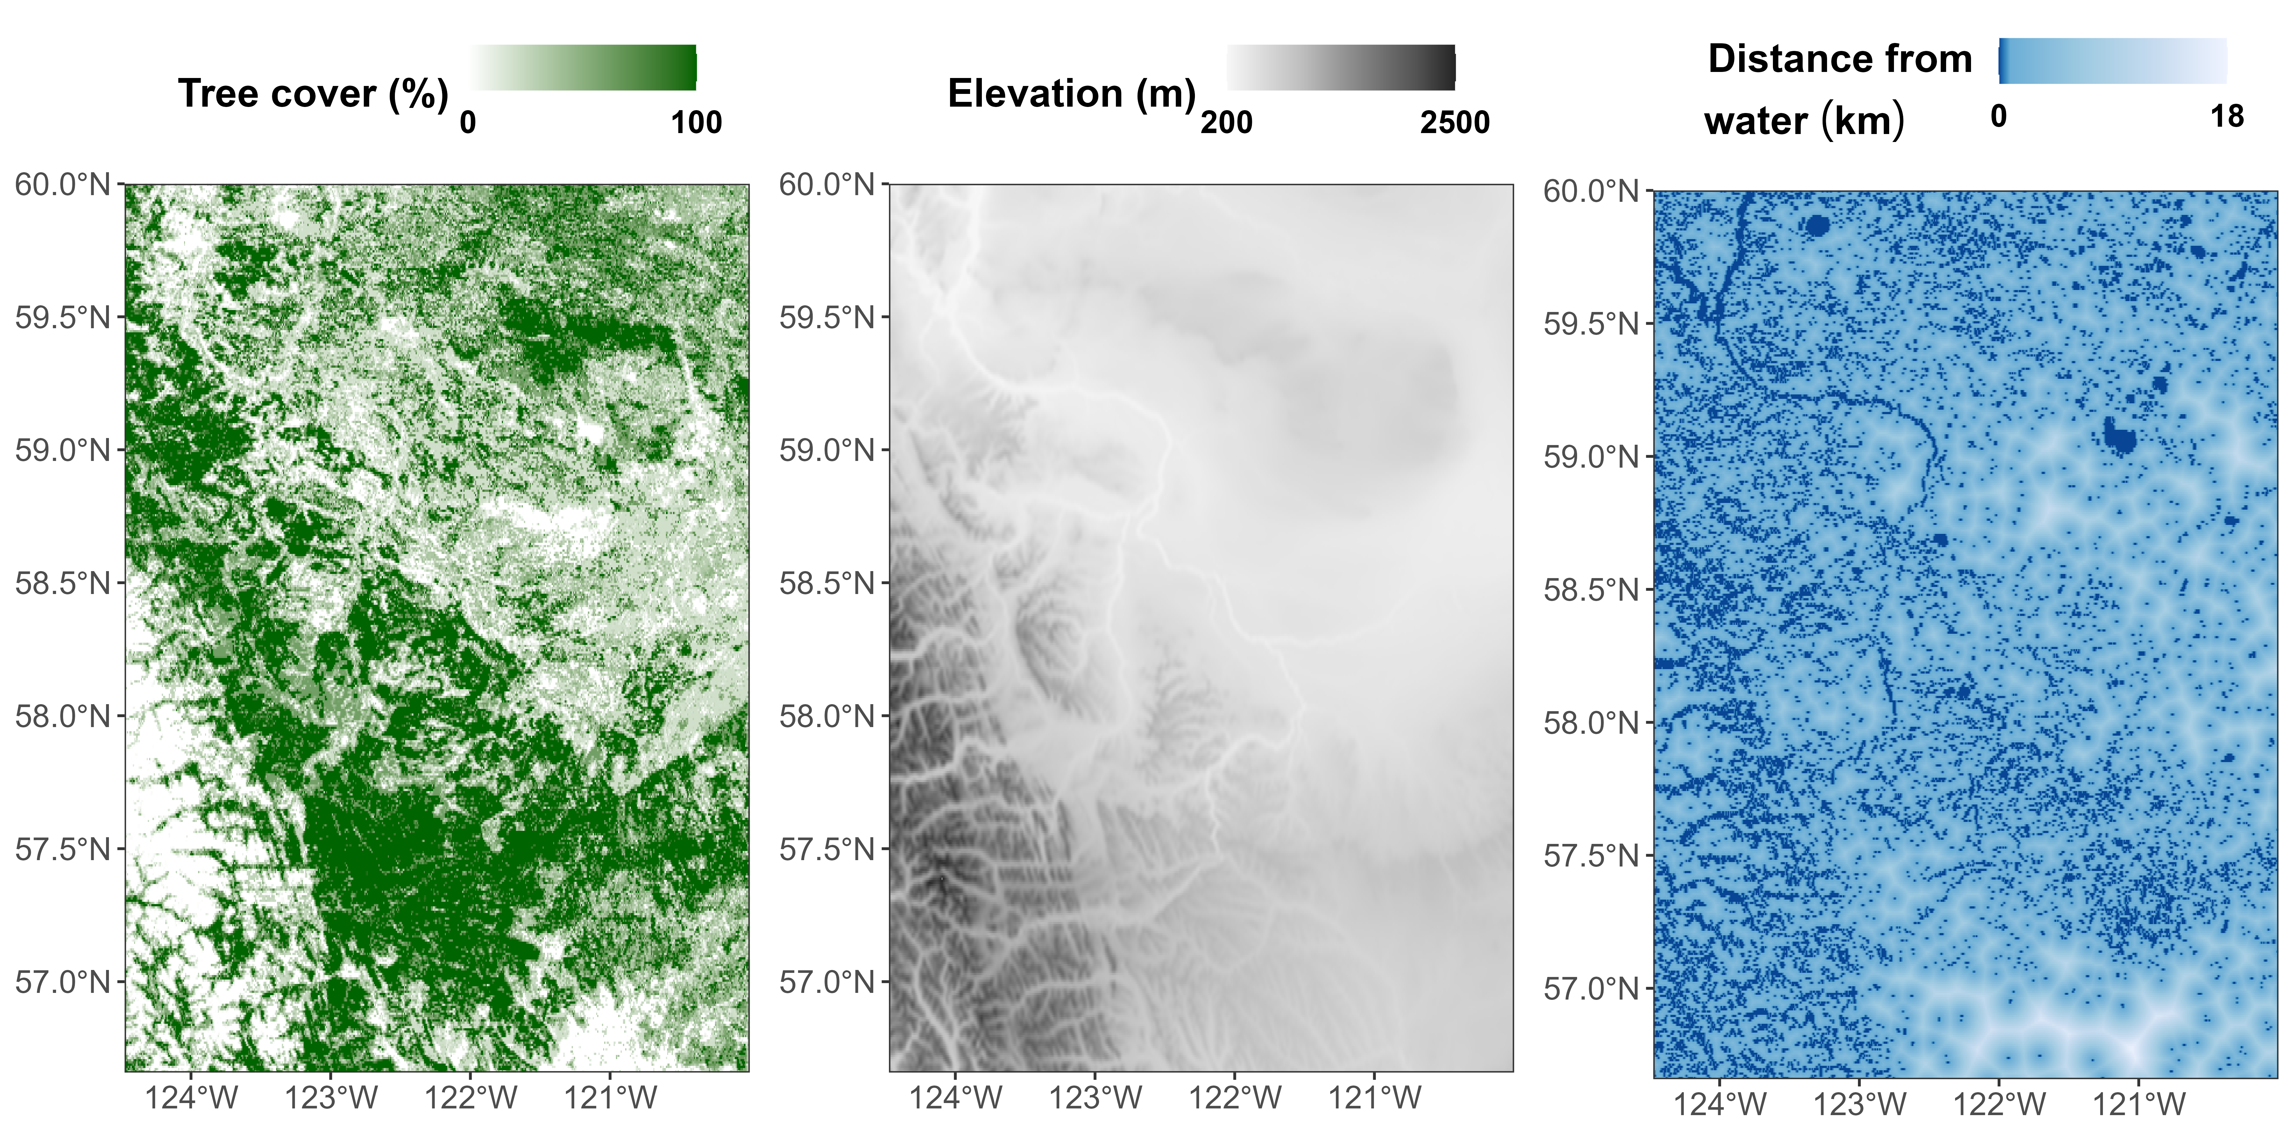
Predicting within the current range

Slide 36

Habitat preference depends strongly on temperature

Slide 37
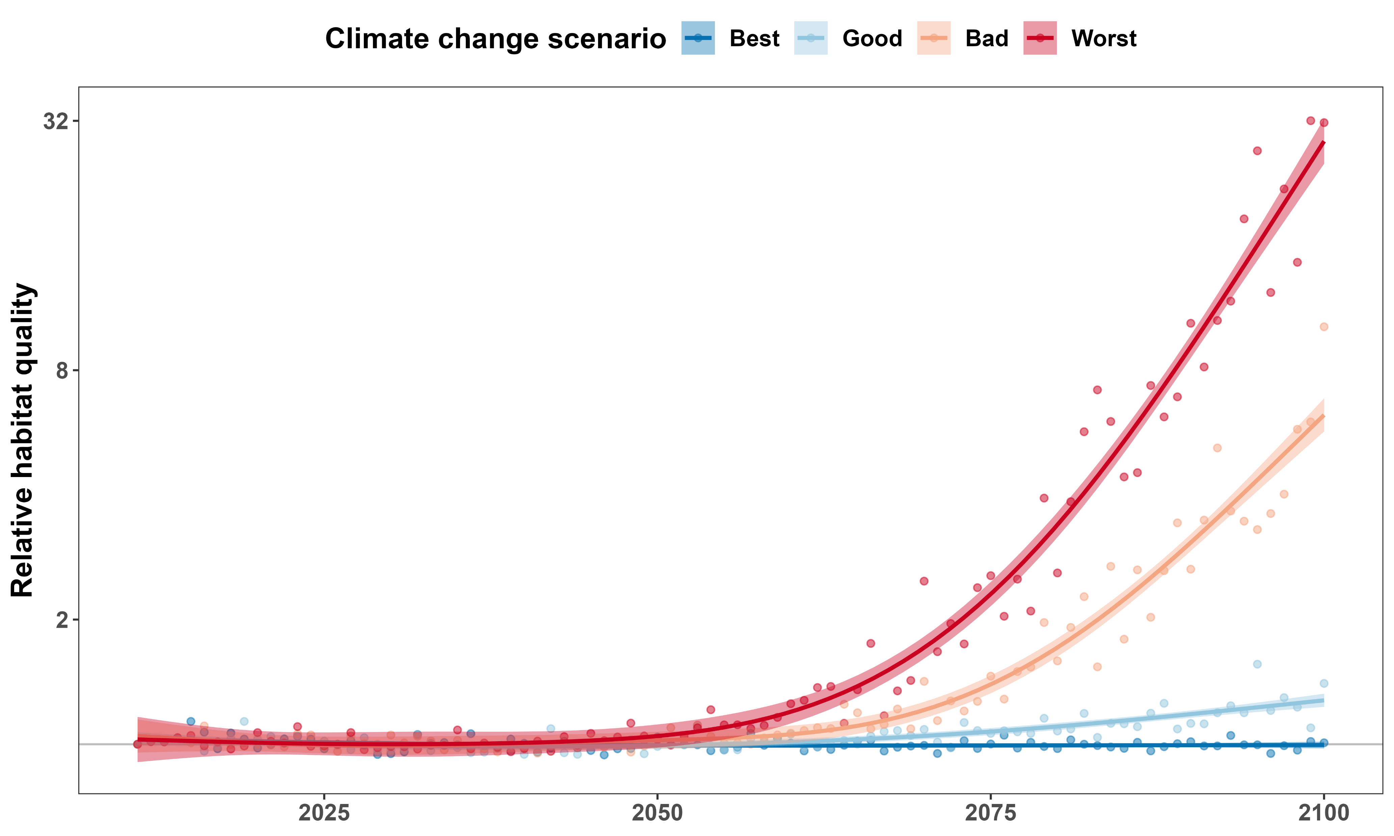
Habitat quality will depend strongly on climate change scenario
Like
Dislike

Slide 38
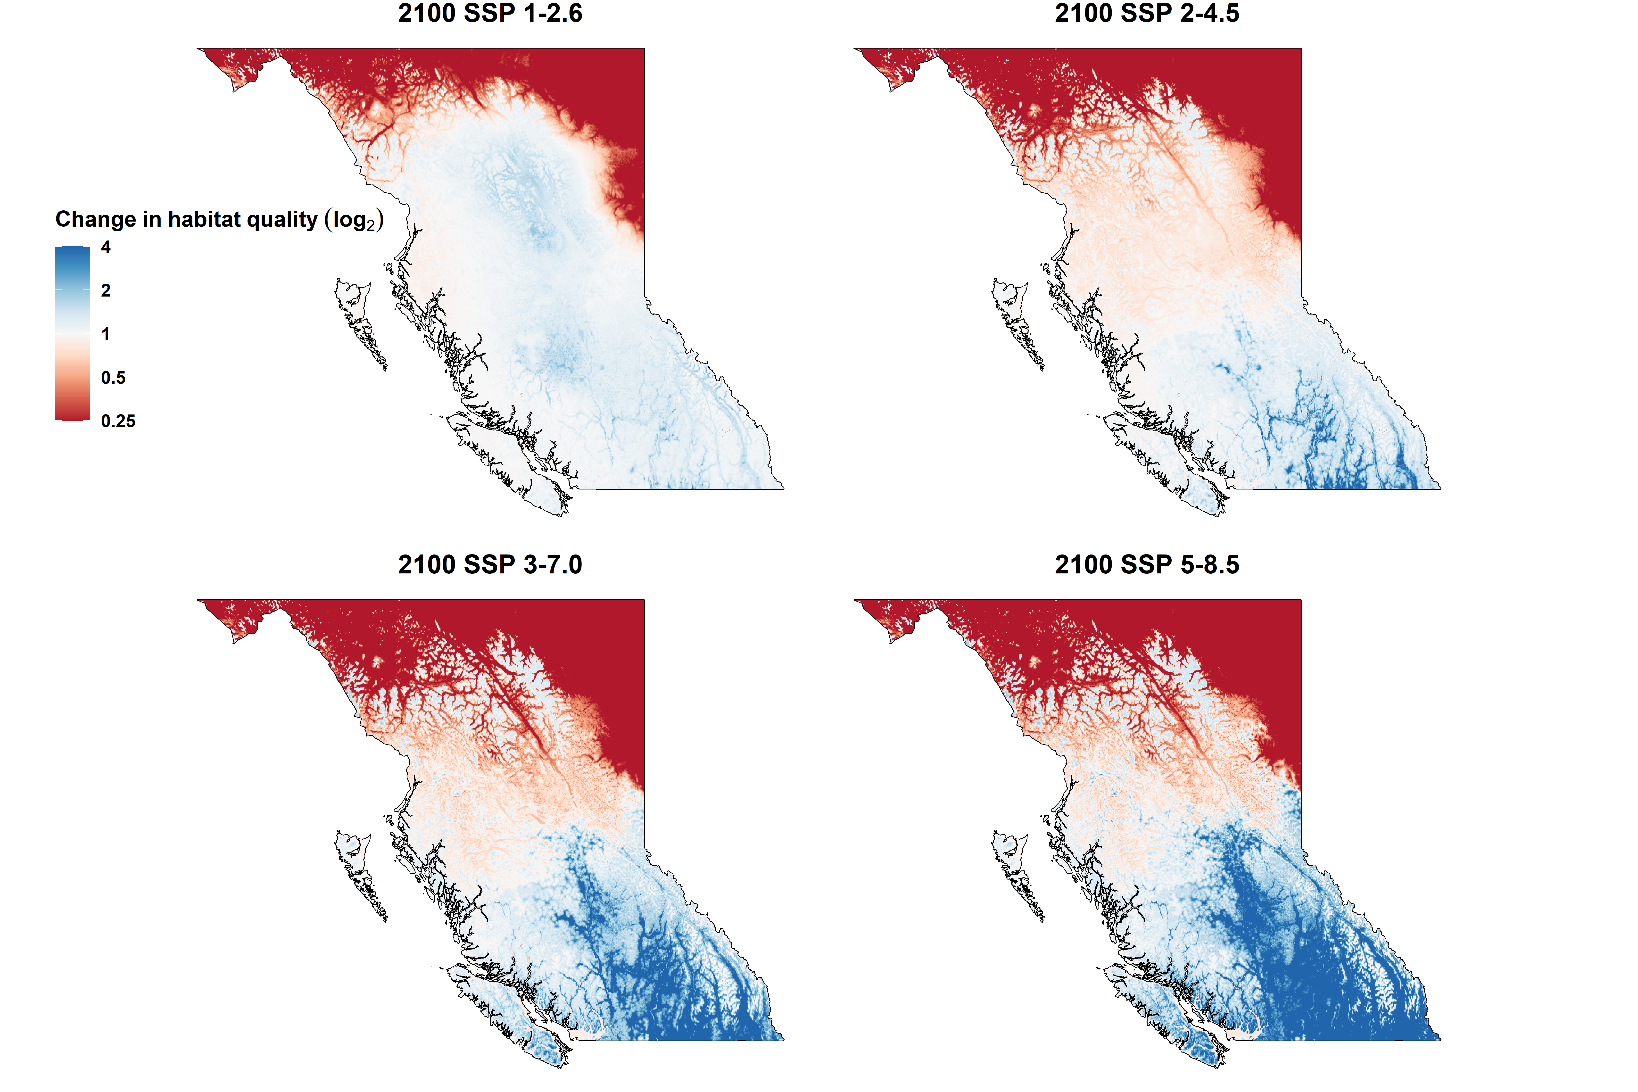
Best scenario
Good scenario
Bad scenario
Worst scenario

Slide 40
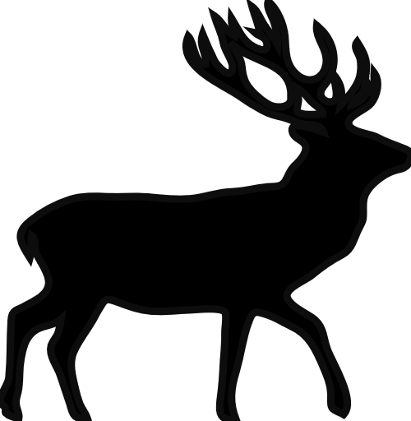
Consequences for conservation
We cannot predict future movement with monthly temperatures:
Need simulations of daily weather
Protect areas proactively
May need to change current protected areas

Slide 41







Acknowledgements

Slide 42
Consequences for conservation
We cannot predict future movement with monthly temperatures:
Need simulations of daily weather
Protect areas proactively
May need to adapt current protected areas

Slide 43
References and credits
Aerial photo of Okanagan Lake: © University of British Columbia Okanagan
Picture of frozen Okanagan Lake: © Kelowna Public Archives: KPA #487
Cougar phylopic: CC BY-NC 3.0: Cristian Osorio & Paula Carrera, Proyecto Carnivoros Australes
Mountain goat phylopic: CC-BY-SA 3.0: Sarah E. Haworth
R code can be found at https://github.com/QuantitativeEcologyLab/bc-mammals-speeds/

